Slide 1

Novae
Analysis of the spectra
An example:
nova Per 2020 with strong oscillations at maximum luminosity
François Teyssier
ARAS group Eruptive stars
www.astronomie-amateur.fr
Shelyak Novae WorkShop
2020, January
Notes:
Bonjour from France

Slide 2
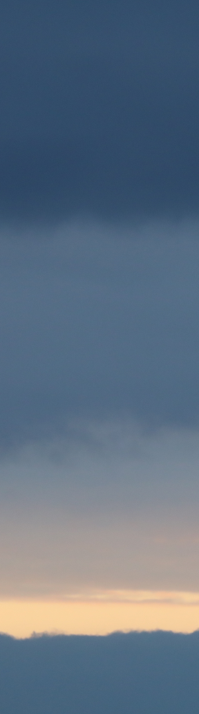
Novae Analysing the spectra
Opacity
Flux incident
λ
λ
Flux émergeant
I₀ (λ)
absorption
τ >> 1
I(λ) = I₀ (λ).exp ^{–τλ}
diffusion
^{τλ: = optical depth}
λ₁
λ₁
λ₂
λ₂
6582 Å
6590 Å
H
τ << 1
α₁λ
α₂λ
α₃λ
τ_{λ} ≡ ∫ α_{n}.dl
l

Slide 3
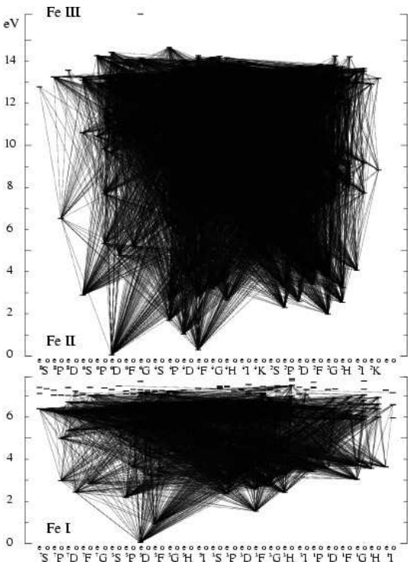
Novae Analysing the spectra
Opacity
[O I]
[NII]
He I
Emission
He II
[OIII]
[Fe VII] …
Nebular lines
Weak H⁰ emission
Many absorptions
(« metals »)
HI Fe II
Emission + Absorption
>10⁵ K
< 10⁴ K
++ 10⁴ K
+++10⁴ K
Iron curtain
« Photosphere » =pseudo-photosphere (τ_{λ} : factor 1 to 100)
Ionisation zone

Slide 4
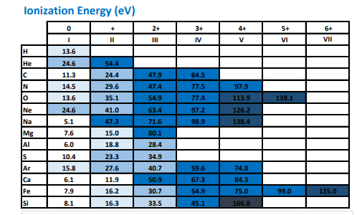
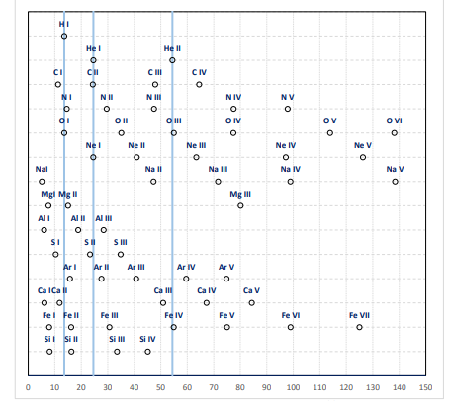
Novae Analysing the spectra
Ionisation level
E = h.ν
E ~ k.T (k = 8.62 10⁻⁵ eV.K⁻¹, Boltzman’s Constant
T (K) ~ 1000 * E.I. (eV)
(Order of magnitude)
Line | T
Na I | 7000
H I Fe OI | 15000
He I | 25000
He II O III | 55000
Fe VII | 125000
Notes:
Theory xls

Slide 5
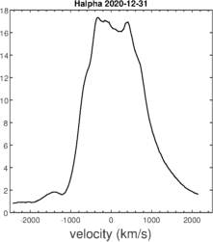
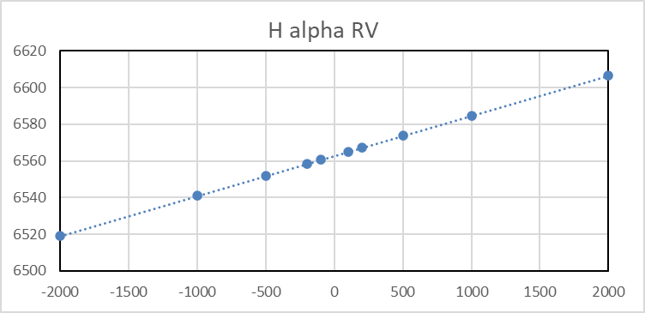
Novae Analysing the spectra
Radial Velocity
Nova Per 2020
Kevin
Note:
Field of the velocities
≠ Physical Field
Doppler effect
Vr = (λ – λ₀)/λ₀ . c
λ = λ₀ . (1+c/ Vr)
Tuning the gratings angle
Analysis of the lines profiles
Photon Hα produced by H⁰ shifted by Vr = -1000 km.s⁻¹
Wavelength = 6540 Å
Notes:
Note: vitesse les plus élevées (valeur absolue) ne correspondent pas nécessairement aux zones les plus éloignées
Champ des vitesses différent de l’espace physique

Slide 6
Novae Analysing the spectra
196 spectra
http://www.astrosurf.com/aras/Aras_DataBase/Novae/2020_NovaPer2020.htm

Slide 7
Novae Analysing the spectra
Echelle R = 10-14000
λ max < 8500 Å
λ max > 8500 Å
Near IR
R = 2000-3000
H alpha R = 15000

Slide 8
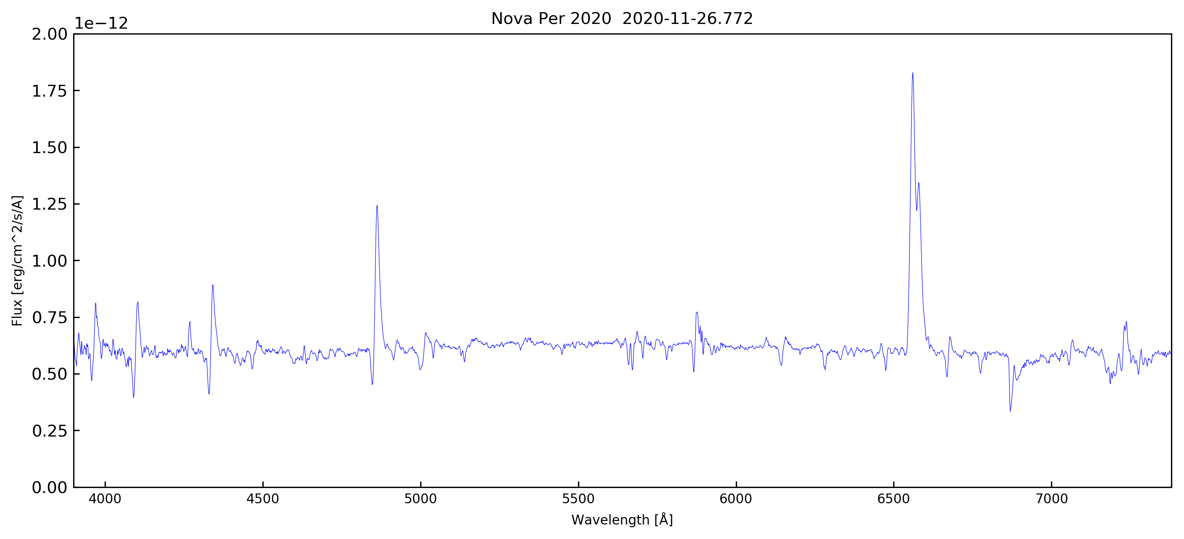
Novae Analysing the spectra
Nova Per 2020
During the Rise
David Boyd LISA (R = 1000) Flux calibrated spectrum (V = )
Hα
Hβ
Hγ
Hε
Hδ
Notes:
Rise: peu de spectres, surtout dans la période « historique »
Apport important ARAS du fait de la grande réactivité
Flux calibration: un plus pour les spectres basse résolution. Une condition: bonne correction de la réponse atmosphérique
Continuum *en apparence* plat – Voir plus loin
Balmer Lines + Profile P Cygni sur Hbeta et raies HI
7235: CII

Slide 9
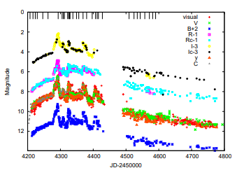
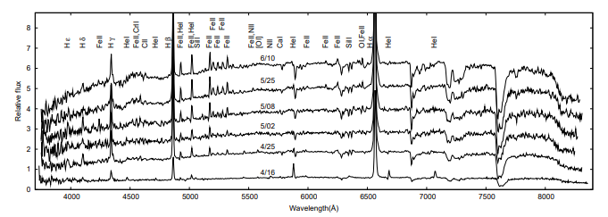
Novae Analysing the spectra
Nova Per 2020
Lines Identification
Publications: commented spectra and sequences
Williams (1990, 1994) « Tololo novae survey)
+++ publications
Lists
General: NIST (https://www.nist.gov/pml/atomic-spectra-database)
Moore
Merrill (1958)
References: Williams (2012) Appendix
http://www.astronomie-amateur.fr/Documents%20Novae/Raies_Novae.pdf
RR Tel (Symbiotic nova)
XX Oph (« Iron Star » )
Tanaka+, 2011 (V5558 Sgr)
Notes:
Plotspectra

Slide 10
Novae Analysing the spectra
Nova Per 2020
During the Rise
David Boyd LISA (R = 1000) Flux calibrated spectrum (V = )
Hα
CII 4267
Hβ
CII 7235
Hγ
Hε
Hδ
The identification of CII 7235 is confirmed by CII 4267
Notes:
Rise: peu de spectres, surtout dans la période « historique »
Apport important ARAS du fait de la grande réactivité
Flux calibration: un plus pour les spectres basse résolution. Une condition: bonne correction de la réponse atmosphérique
Continuum *en apparence* plat – Voir plus loin
Balmer Lines + Profile P Cygni sur Hbeta et raies HI
7235: CII

Slide 11
Novae Analysing the spectra
Nova Per 2020
During the Rise
David Boyd LISA (R = 1000) Flux calibrated spectrum (V = )
Hα
CII 4267
Hβ
He I 5876
He I 6678
CII 7235
Hγ
Hε
Hδ
The identification of CII 7235 is confirmed by CII 4267
Notes:
Rise: peu de spectres, surtout dans la période « historique »
Apport important ARAS du fait de la grande réactivité
Flux calibration: un plus pour les spectres basse résolution. Une condition: bonne correction de la réponse atmosphérique
Continuum *en apparence* plat – Voir plus loin
Balmer Lines + Profile P Cygni sur Hbeta et raies HI
7235: CII

Slide 12
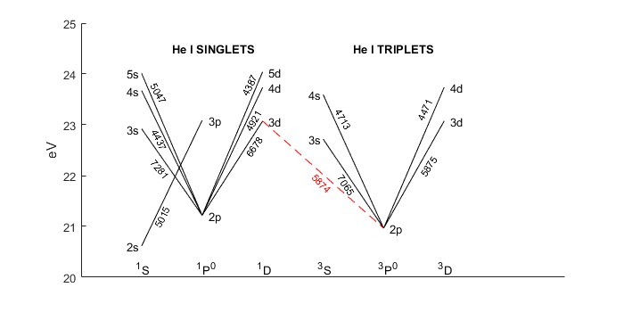
Novae Analysing the spectra
1/4
3/4
2s
Main He I transitions in the visible range
Singlets
Triplets
Transition | λ (Å)
4s →2p | 4437
4d → 2p | 4921
3p → 2s | 5015
3d → 2p | 6678
Transition | λ (Å)
4d →2p | 4471
4s → 2p | 4713
3d → 2p | 5875
3s → 2p | 7065

Slide 13
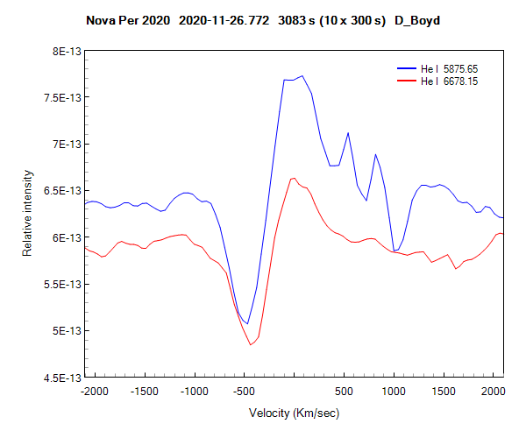
Novae Analysing the spectra
The identification of He I 6678 (singlet) is confirmed by He I 5876 (triplet)
Note the emissions of Na I D₂, D₁

Slide 14
Novae Analysing the spectra
Nova Per 2020
Montée en luminosité (Rise)
David Boyd LISA (R = 1000) Flux calibrated spectrum (V = )
Hα
Hβ
He I 5876 + Na I D
CII 4267
He I 6678
CII 7235
Hγ
Hε
Hδ

Slide 15
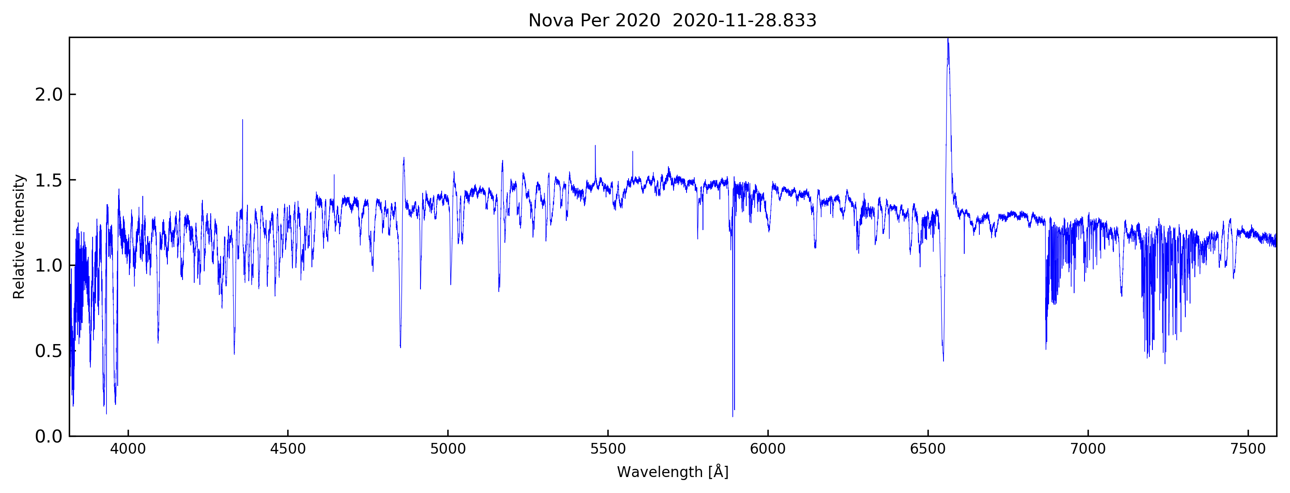
Novae Analysing the spectra
Nova Per 2020
Maximal Luminosity
Christian Buil eShel2 (R = 11000)
Flat continuum – very strong absorptions of Na I D
P Cygni profiles Balmer lines, Fe II (42)
Very narrow emissions
Notes:
Absorptions
NaID Ca II H & K: ionisation
Balmer

Slide 16
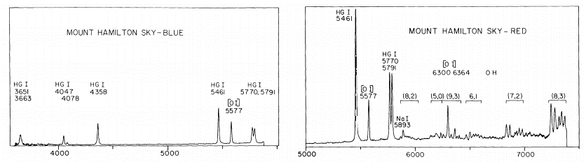
Novae Analysing the spectra
Nova Per 2020
Maximal Luminosity
« Cleaning the spectrum»
Line | Sources
Hg I 3650 | Hg lighting
Hg I 3663 | Hg lighting
Hg I 4047 | Hg lighting
Hg I 4078 | Hg lighting
Hg I 4358 | Hg lighting
Na I 4665, 4669 | HPS
Na I 4748, 4752 | HPS
Na I 4978, 4983 | HPS
Na I 5149, 5153 | HPS
Hg I 5461 | Hg lighting
Na I 5683, 5688 | HPS, LPS
Hg I 5770 | Hg lighting
Hg I 5791 | Hg lighting
Na I 5890, 5896 | HPS, LPS, airglow
Na I 5700 - 6100 | HPS
Na I 6154, 6161 | HPS, LPS
K I 7665 | HPS, LPS
K I 7699 | HPS, LPS
Na I 8183 | HPS, LPS
Na I 8195 | HPS, LPS
Buil your own light pollution map
Notes:
Construisez votre propre carte de la pollution lumineuse

Slide 17
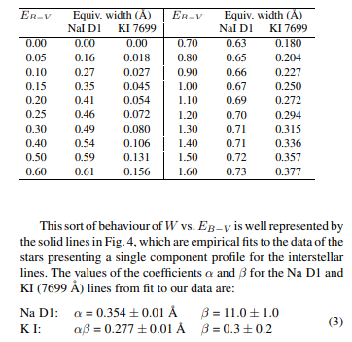
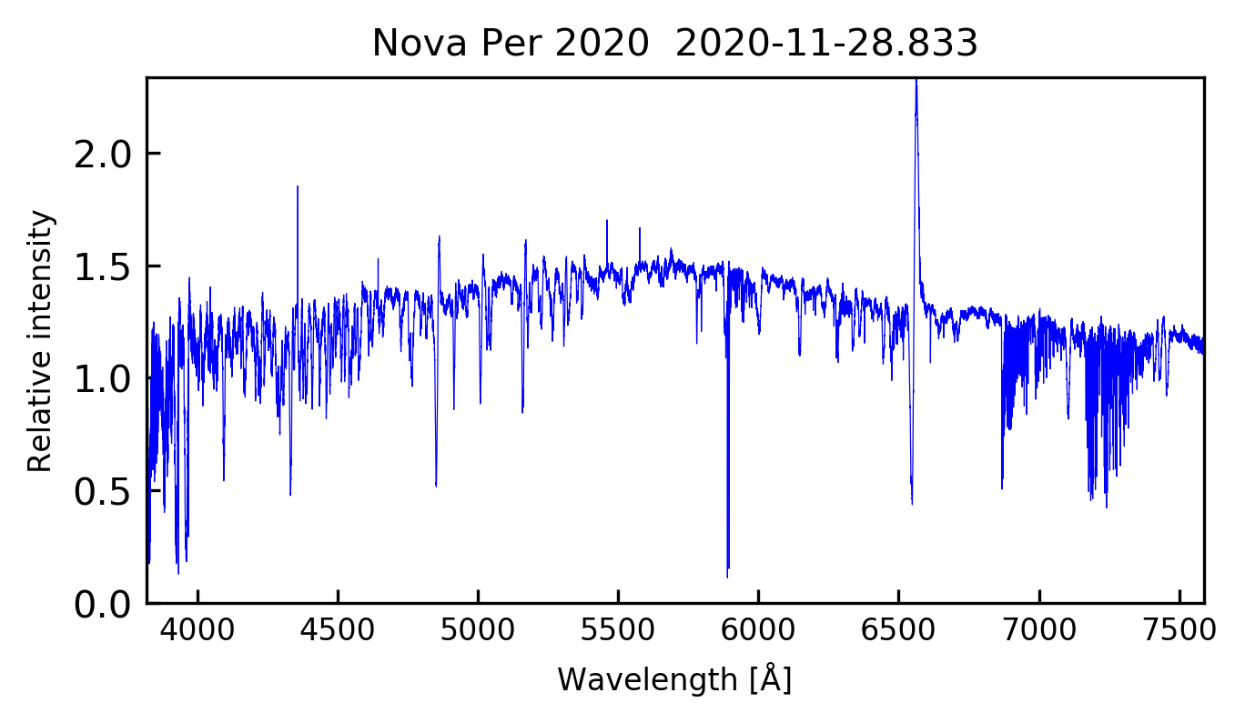
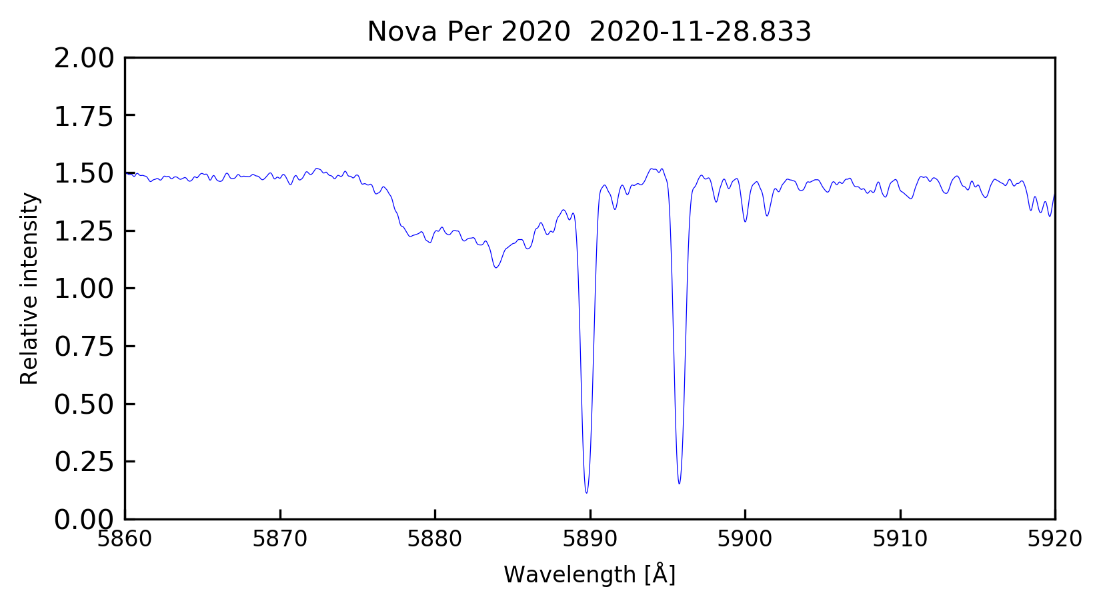
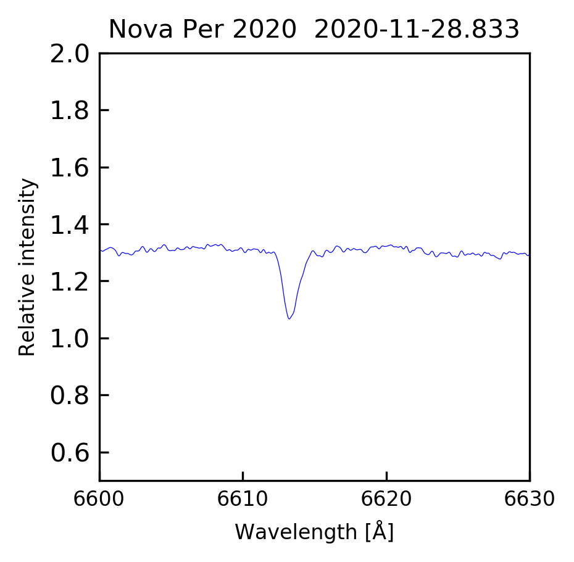
Novae Analysing the spectra
Nova Per 2020
Maximum Luminosity
Munari & al.,
E_{B-V} as a function of
EW Na I D
et K I 7699Å
DIB λ 6614 Å
D2
D1
D2
D1
N : Nova
IS : Interstellar
N
N
IS
IS
E.W. (Na I D1) = 0.77 Å
E.W. (λ 6614 Å ) = 0.22 Å

Slide 18
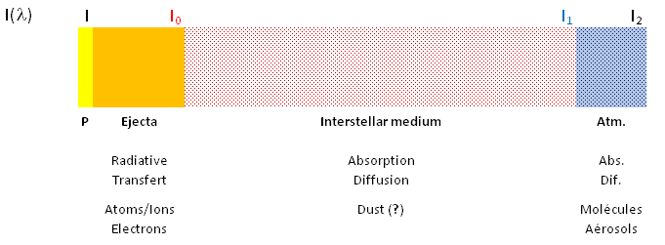
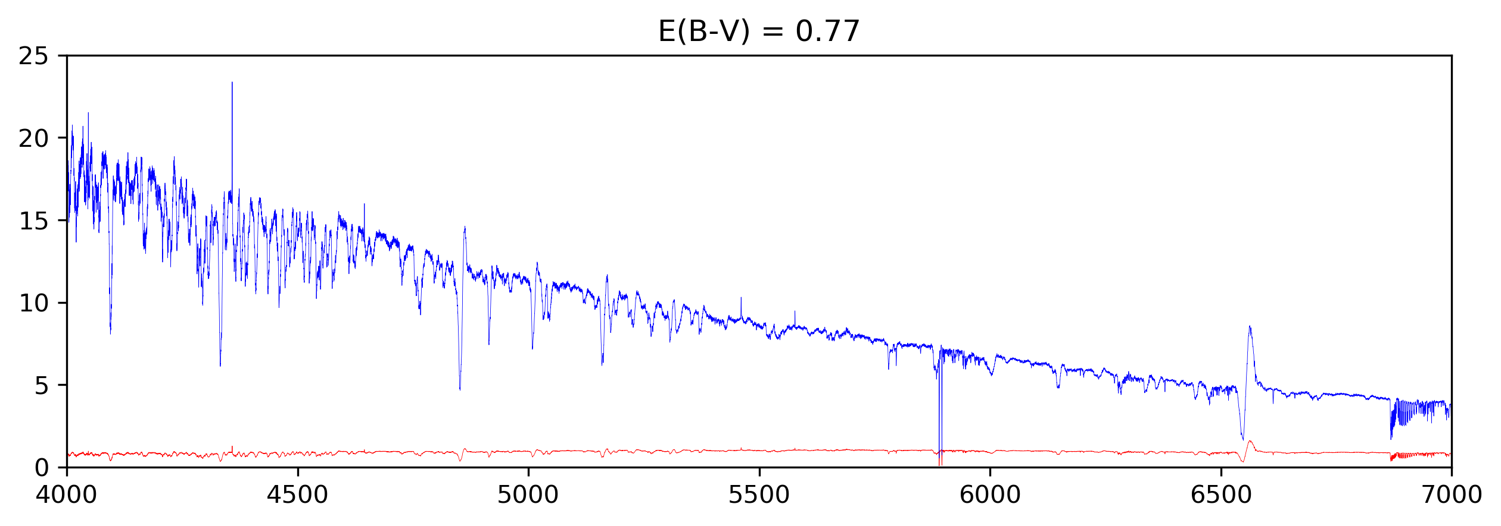
Novae Analysing the spectra
Nova Per 2020
I (λ)
I_{p}
I₀
I₁
I₂
Derredening the spectrum
(Python, AstroPy)
E_{B-V} = 0.77
Red: the observed spectrum after atmospheric/intrumental correction = I₁(λ)
Blue: the derredened spectrum as it emerges from the ejecta = I₀(λ)
Notes:
Type stellaire → Gray & Corbally

Slide 19
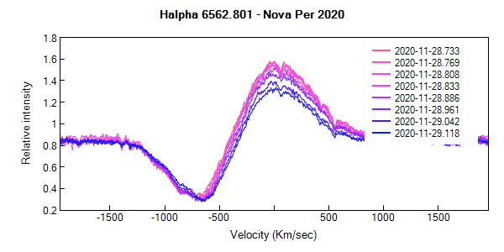
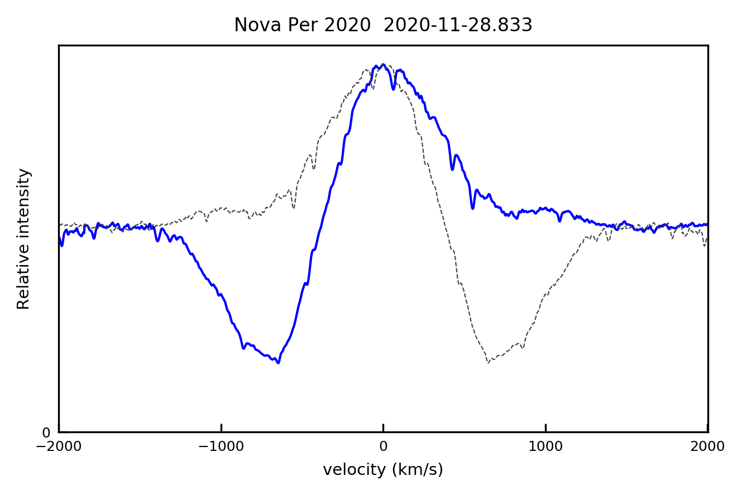
Novae Analysing the spectra
Nova Per 2020
Maximum
Nightly Variation of H alpha
Profile + reversed profile
-1426 km.s⁻¹
+1423 km.s⁻¹
-642 km.s⁻¹
S. Charbonnel (6), C. Buil (1), F. Teyssier (1) Echelle R = 11000

Slide 20
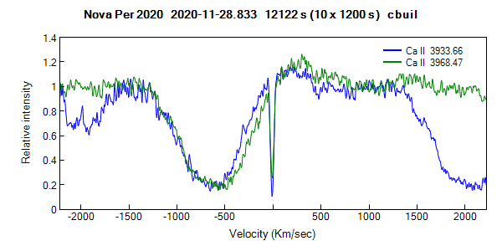
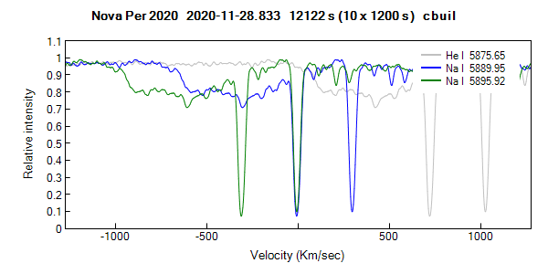
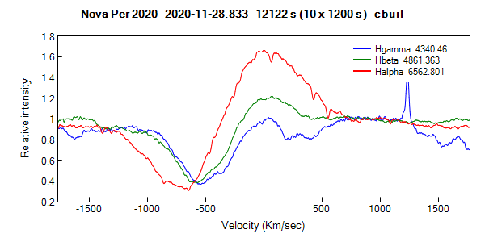
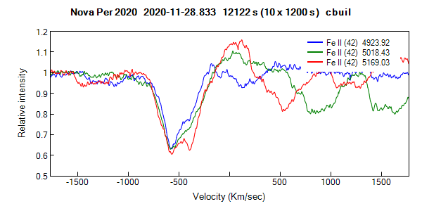
Novae Analysing the spectra
Nova Per 2020
Maximum
IS

Slide 21
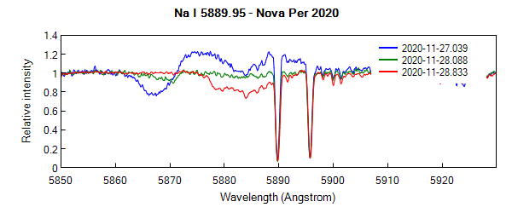
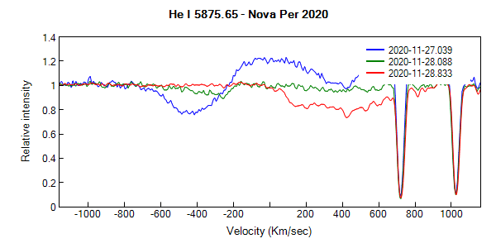
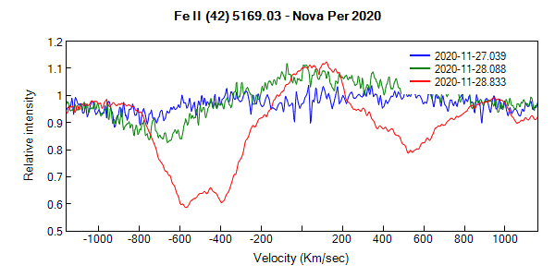
Novae Analysing the spectra
Nova Per 2020
Rise
Spectres eShel Olivier Garde (26-27) et C. Buil (28)

Slide 22
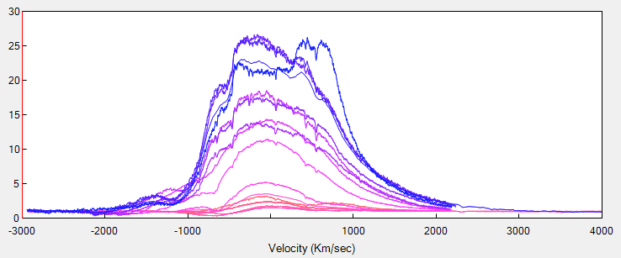
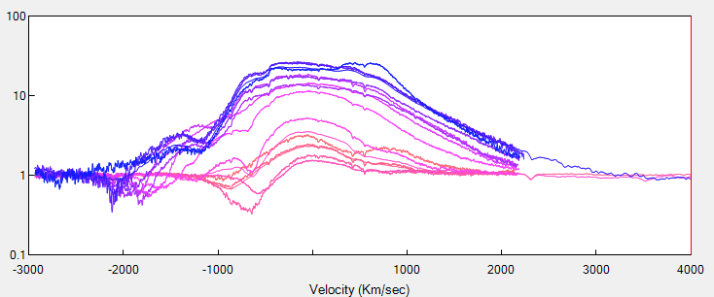
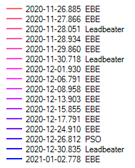
Novae Analysing the spectra
Nova Per 2020
Hα at high resolution
Lhires III
EBE: Etienne Bertrand 2400 l/mm R= 15000
Leadbeater: Robin L. 1200 l/mm R = 5500
PSO: Peter Somogyi 2400 l/mm R = 21000
Notes:
Wsérie HR

Slide 23
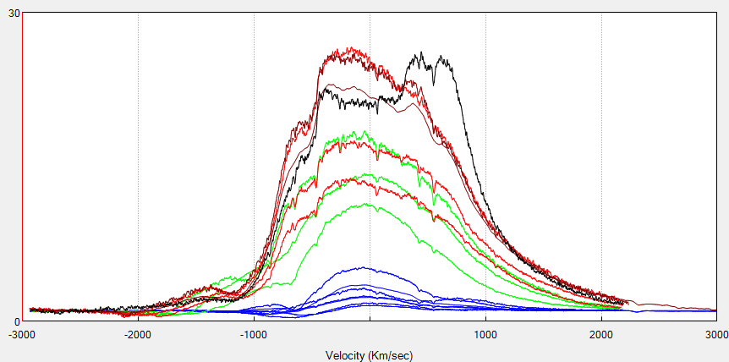
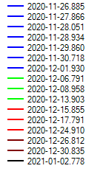
Novae Analysing the spectra
Nova Per 2020
Hα
-430 km.s⁻¹
+460 km.s⁻¹

Slide 24
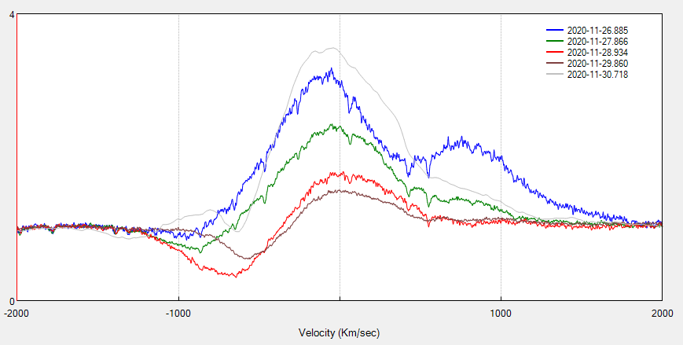
Novae Analysing the spectra
Nova Per 2020
Hα
λ 6579 Å
+760 km.s⁻¹
-625km.s⁻¹
-1600 km.s⁻¹
-1200 km.s⁻¹
-1800 km.s⁻¹
-950 km.s⁻¹
-860 km.s⁻¹
-570 km.s⁻¹
-650 km.s⁻¹

Slide 25
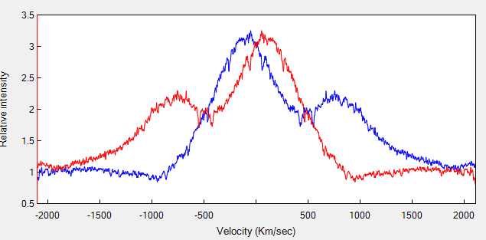
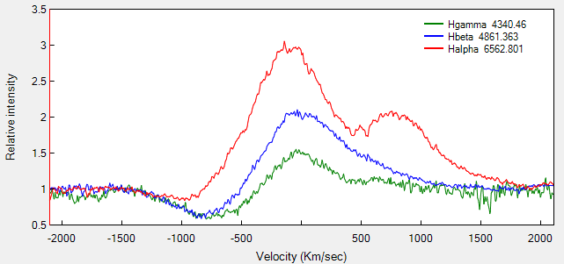
Novae Analysing the spectra
Nova Per 2020
Hα
Component λ 6579 Å
Does not beyong to Hα

Slide 26
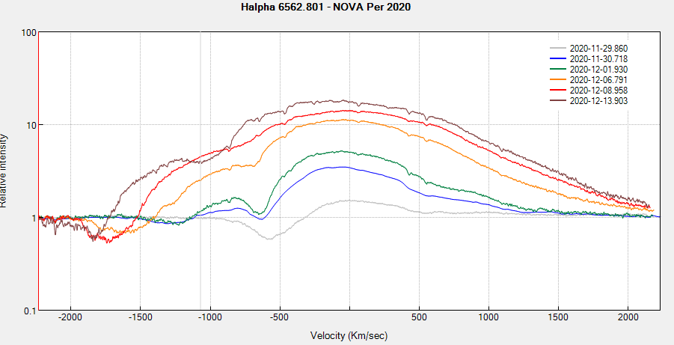
Novae Analysing the spectra
Nova Per 2020
Hα
-2170 km.s⁻¹
Notes:
Absorptions multiples

Slide 27
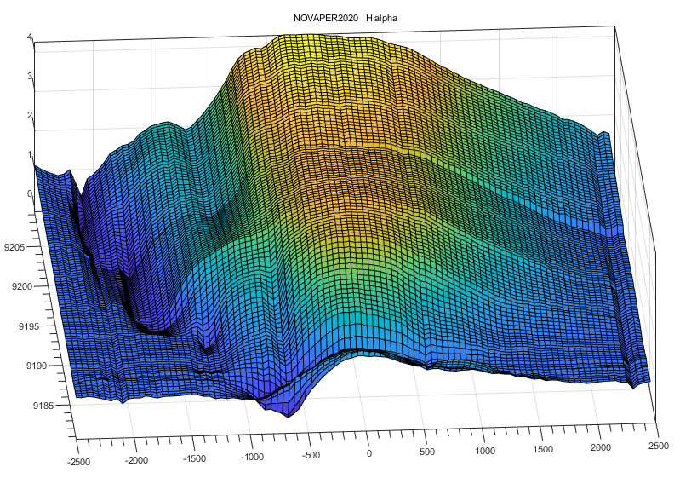
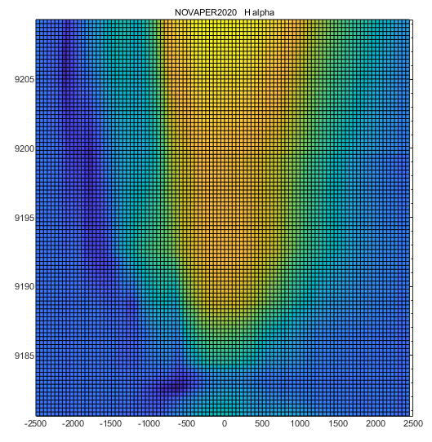
Novae Analysing the spectra
Nova Per 2020
Hα
Echelle spectra (R = 10 à 14000) Olivier Garde, Stéphane Charbonnel, Joan Guarro, Tim Lester, Christian Buil, François Teyssier
Notes:
Ouvrir Matlab

Slide 28
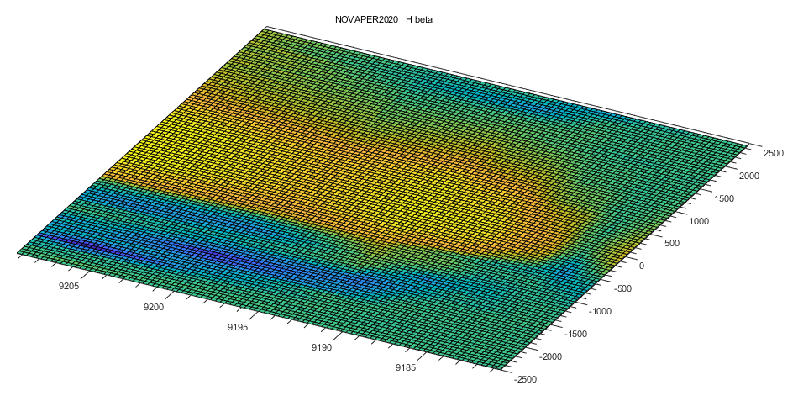
Novae Analysing the spectra
Nova Per 2020
Hα
Echelle Spectra (R = 10 à 14000) Olivier Garde, Stéphane Charbonnel, Joan Guarro, Tim Lester, Christian Buil, François Teyssier
Notes:
Ouvrir Matlab

Slide 29
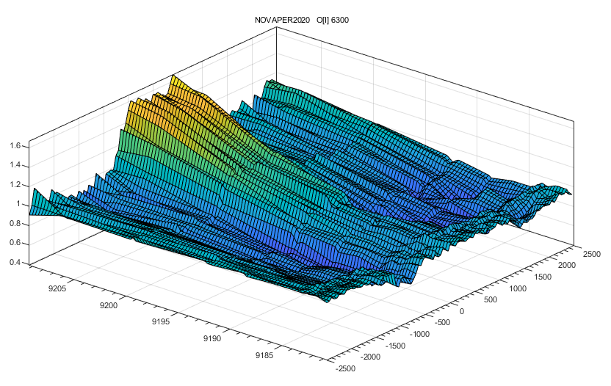
Novae Analysing the spectra
Nova Per 2020
Hα
Echelle Spectra(R = 10 à 14000) Olivier Garde, Stéphane Charbonnel, Joan Guarro, Tim Lester, Christian Buil, François Teyssier
Notes:
Ouvrir Matlab

Slide 30
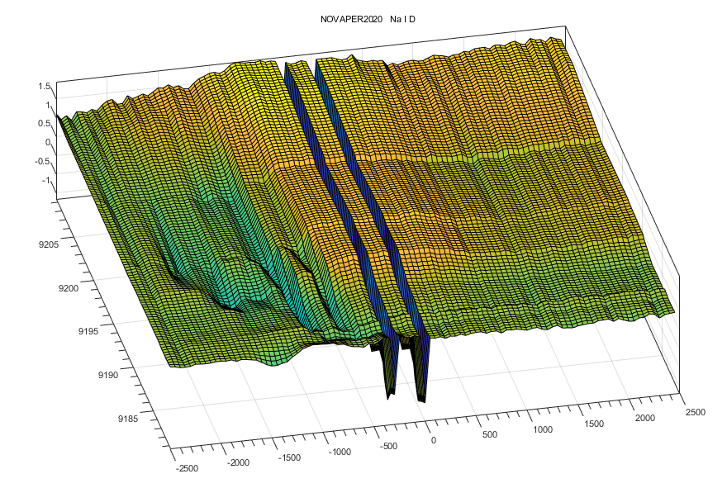
Novae Analysing the spectra
Nova Per 2020
Hα
Echelle Spectra(R = 10 à 14000) Olivier Garde, Stéphane Charbonnel, Joan Guarro, Tim Lester, Christian Buil, François Teyssier
Notes:
Ouvrir Matlab

Slide 31
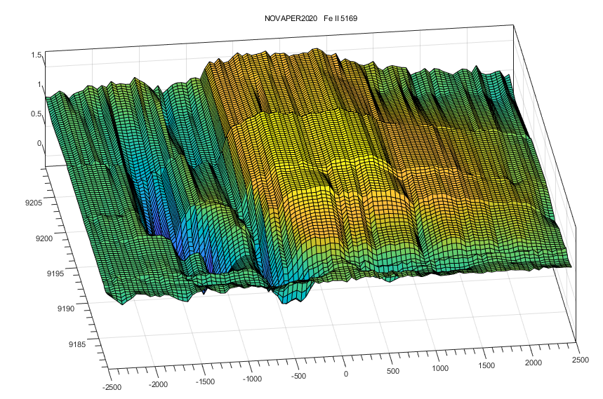
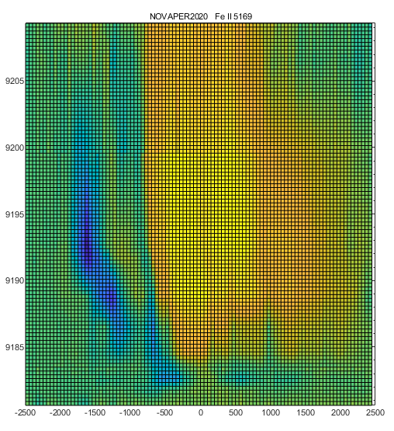
Novae Analysing the spectra
Identification des raies

Slide 32
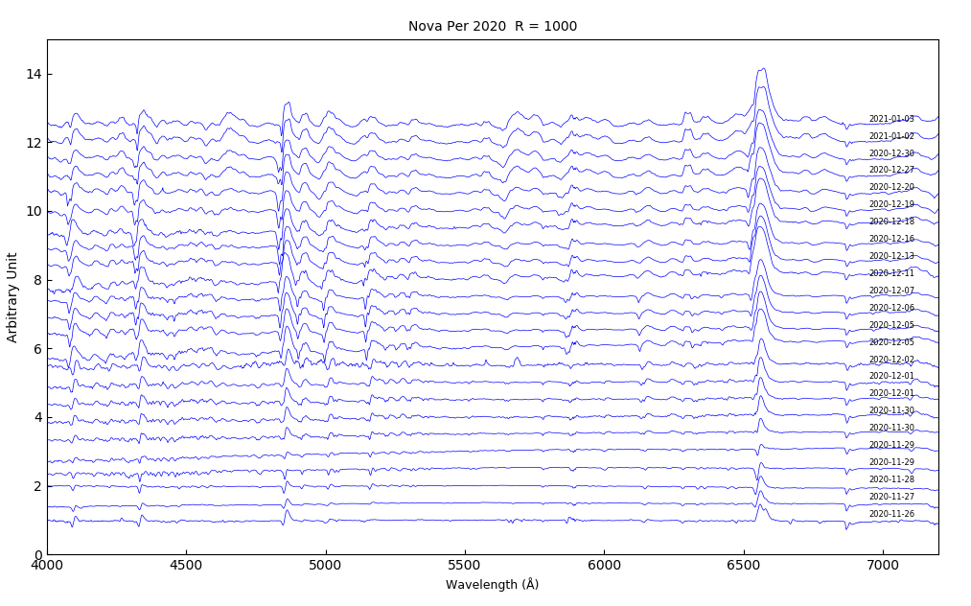
Novae Analysing the spectra
LISA R = 1000
Add Observers List
?
Notes:
Python

Slide 33
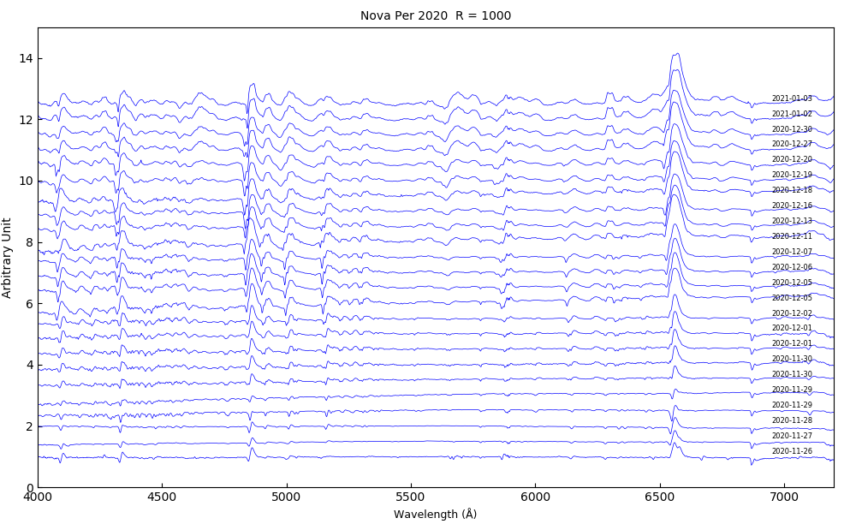
Novae Analysing the spectra
LISA R = 1000
Add Observers List
He I
He I
He I
He I
Notes:
Python

Slide 34
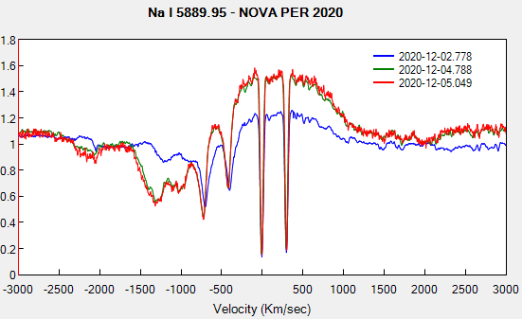
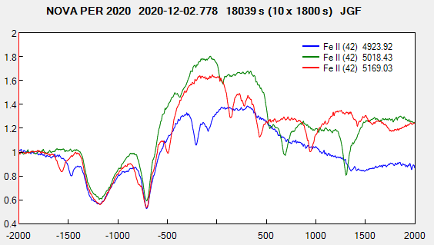
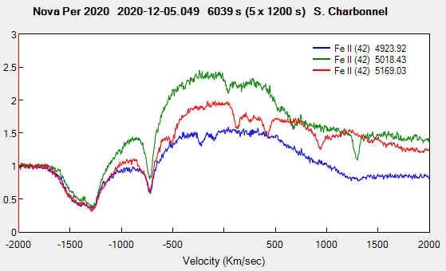
Novae Analysing the spectra
Right: the comparison of the lines of a multiplet allows
tho determine what belong to the lines
Notes:
PlotSpectra
Na I D → Fe II

Slide 35
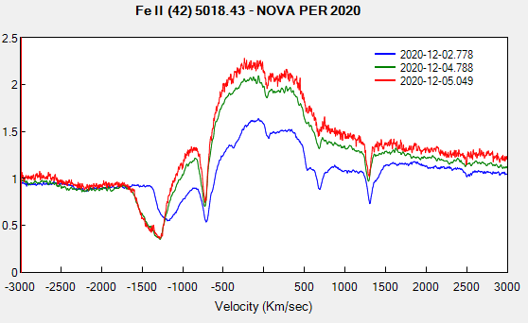
Novae Analysing the spectra
Notes:
PlotSpectra
Na I D → Fe II

Slide 36

Novae Analysing the spectra
Nova Per 2020
Oxygen
O⁰ OI EI = 13.6 eV
O⁺ OII EI = 35.1 eV
O⁺⁺ OIII EI = 54.9 eV
Raie | lambda (Å)
[O II] | 3726.03
[O II] | 3728.82
[O III] | 4363.21
[O III] | 4931.23
[O III] | 4958.91
[O III] | 5006.84
[O I] | 5577.40
[O I] | 6300.32
[O I] | 6363.78
[O I] | 6391.73
O I | 7002.23
O I | 7254.50
[O II] | 7318.92
[O II] | 7319.99
[O II] | 7329.67
[O II] | 7330.73
O I | 7773.50
O I | 8446.50
15
Ionisation 13.6 eV
5s
7254
7002
4d
4s
3d
3p
3p
10
1026
[O I] λ 6300
[O I] λ 6363
OI λ 7773
OI λ 8446
3s
8446
7774
3s
5
2p
5577
2p
0
6300-63
2p
¹S
¹D
³S
³P
³D
⁵S
⁵P
Joan Guarro Echelle R = 10000
Gaussian filter + log scale
Singlets
Triplets
Quintets
Notes:
Même niveau ionisation +1 que H

Slide 37



Novae Analysing the spectra
Nova Per 2020
O I
Transition
O I
(O⁰)
H I
H⁰ H⁺
O I
(O⁺)
[O I]
(O⁰ N_{e} Weak
Physical conditions
λ 11286.9
λ 8446.36
λ 7773.50
λ 1025.76
Lyman β
λ 5557.4
1025.72
λ 6300.3
e
λ 6363.8
Main Process
Resonnance-Fluorescence
Recombinaison
Electronic Collision
Notes:
Test Bowen: Intensités 11286 & 8446 +7002 7254

Slide 38

Novae Analysing the spectra
Nova Per 2020
O I

Slide 39


Novae Analysing the spectra
Nova Per 2020
O I
Iso-electronic sequence
NII E.I. = 29.6 eV
OI E.I = 13.6 eV

Slide 40


Novae Analysing the spectra
Nova Per 2020
O
Model built by Steve Shore
Observations

Slide 41


Novae Analysing the spectra
Nova Per 2020
O
The ejecta modelized by Steve Shore

Slide 42

Novae Analysing the spectra
Nova Per 2020
Spectres near IR Paolo Berardi, Umberto Sollechia, Robin Leadbeater
Spectre Umberto Sollecchia Lhires III 600 l/mm R = 2400

Slide 43


Novae Analysing the spectra
Nova Per 2020
Proche UV
Pierre Dubreuil UVEX4

Slide 44
Novae Analysing the spectra
Nova Per 2020
Low res current status
Forrest Sims Flux calibrated (V = )LISA R = 1000
Add last variations

Slide 45



Novae Analysing the spectra
Nova Per 2020
Derniers profiles H alpha

Slide 46

Novae Base de Données
+ ARAS observations in the web pages built by Christian Buil

Slide 47

Novae Base de Données

Slide 48


Information letter
Main results in a quaterly newsletter
Produced by François Teyssier, David Boyd, Forrest Sims
46 issues downloadable: http://www.astrosurf.com/aras/novae/InformationLetter/InformationLetter.html
Indexed in NASA/ADS since January, 2019
Education of the observers:
With notes from
Steve Shore
Agustin Skopal, Natalia Shagatova
Rudolf Gàlis, Jaroslav Marc, Leedjarv
Margarita Karovska
….
François Teyssier

Slide 49
Merci à Steve Shore pour son soutien inlassable depuis 2013, ses notes dans la lettre d’information, ses explications …
Merci à David Boyd et Forrest Sims pour leur participation active à la lettre d’information,
Merci à tous les observateurs qui ont contribué à accumuler plus de 2000 spectres de novae, avec une pensée particulière pour nos collègues de l’hémisphère sud, Terry Bohlsen, Paul Luckas, Colin Elridge.
Un grand merci à Colin Elridge pour son magnifique spectre echellede CN Cha
Thank you to the professional teams who trusted us and used our spectra for their research and publications.
Thank you to them for respecting the rules for using the spectral base.
I would therefore like to thank, instead of Aydi + (2020):
R. Marcon, T. Napoleo, Terry Bohlsen, Joan Guarro, Christian Buil,
*which should have been done in this publication*.
List of Observers of Nova Per 2020
Paolo Berardi
Christian Buil
Sean Curry
David Boyd
Etienne Bertrand
Forrest Sims
Franck Boubault
Lorenzo Franco
François Teyssier
John Coffin
Joan Guarro Flo
Jacques Michelet
Jean-Michel Vienney
Kevin Gurney
Keith Shank
Tim Lester
James Ley
Matthieu Le Lain
Marion Thomas & Christophe Boussin
Olivier Garde
Pavol Dubovski
Paolo Cazzato
Jean-Louis Dumont & Pierre-Jean Mercier
Pascal Le Du
Robin Leadbeater
Stéphane Charbonnel
Umberto Sollecchia
Thibault de France
Antonino Ventura
Thierry Garrel
Pierre Dubreuil
English workshop 2021-01-16 on youtube
Introduction to the Theory of Novae
https://www.youtube.com/watch?v=Peo8w6j0jhc
Analysing Nova Per 2020 spectra
https://www.youtube.com/watch?v=CUHJBnh8QnA
François Teyssier

