Slide 1
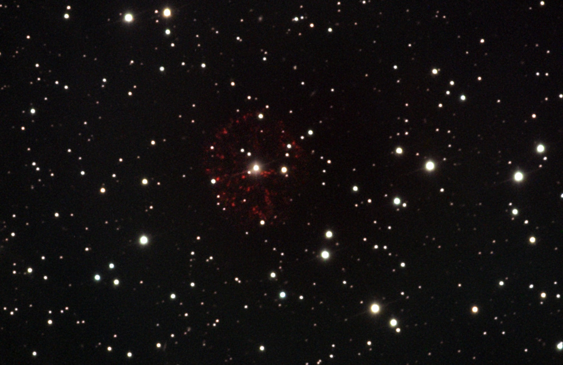
Novae
GK Per (Nova Per 1901) – Crédit : Adam Block/NOAO/AURA/NSF
F. Teyssier January 2021

Slide 2
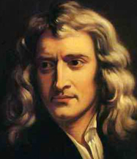
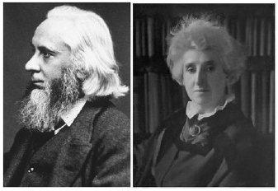
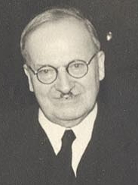
Novae | Short Story
Newton (1726)
Une intuition géniale
Les étoiles fixes, qui se sont graduellement appauvries en éjectant de la lumière et des vapeurs durant très longtemps peuvent être régénérées par des comètes qui tombent sur elles ; et par cet apport de nouveau carburant ces vieilles étoiles, acquérant une nouvelle splendeur, peuvent passer pour de nouvelles étoiles.
William & Margaret Huggins (1866)
First spectra of a Nova
Lundmark (1920)
The « Great debate »
Classification of the ‘new stars’’ en 3 categories :
Supernovae – Classical Novae – Dwarf Novae
F. Teyssier January 2021

Slide 3

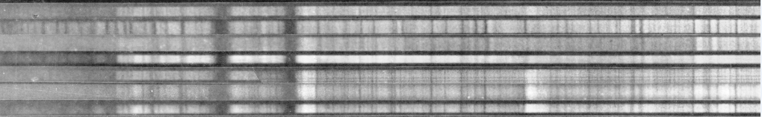
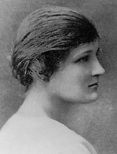
Novae | Short Story
Mc Laughlin
Systematic study of the bright novae in the first part of the XXth Century
Nova Her 1936
First publication of the spectra secured by several observatories
Cécilia Payne-Gasposhkin (1957)
Galactic Novae
First book about Novae
F. Teyssier January 2021

Slide 4
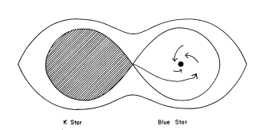
Novae | Short Story
Walker,1954
DQ Her (Nova Her 1934) is an eclipsing binary star
Kraft,1962
Hypothesis :
All cataclysmic stars are binaries
The novæ are produced by a nuclear explosion
at the surface of a white dwarf
Model AE Aur
Crawford & Kraft, 1956
F. Teyssier January 2021

Slide 5
Novae | Photometry - Luminosity Curves
Luminosity curve (V) of a classical nova : Nova Del 2013
AAVSO DataBase
F. Teyssier January 2021

Slide 6
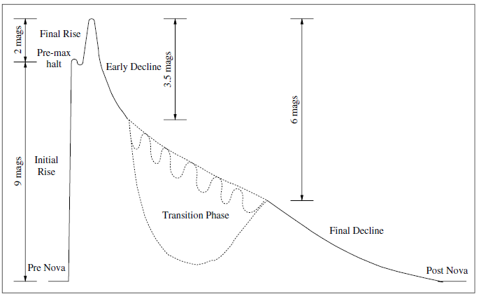
Novae | Photometry - Luminosity Curves
Classical luminosity curve
Classical Novae, first edition (Bode & Evans, 1989)
From Mc Laughlin
F. Teyssier January 2021

Slide 7
Novae | Photometry - Luminosity Curves
Speed classes
Max
2 mag
3 mag
t₂ = 15 j
t₃ = 31 j
 | T₂ (days) | T₃ (days)
Very Fast | < 10 | < 20
Fast | 11-25 | 21-49
Sparingly Fast | 26-80 | 50-140
Slow | 81-150 | 141-264
Very Slow | 151-250 | 265-440
Empirical relation t₂, t₃
t₃ = t₂^{0.88}
Warner, 1995
Payne-Gaposcschkin, 1959
F. Teyssier January 2021

Slide 8
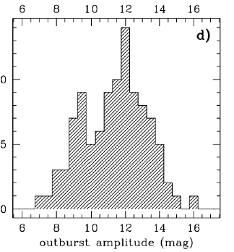
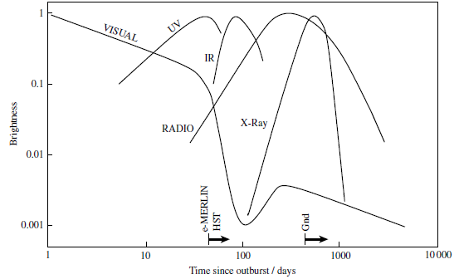
Novae | Photometry - Luminosity Curves
Range of the Outburst
Bolometric luminosity: ~ constant
Energy released ~ 10⁴⁶ erg (in 1 year)
~ 100 000 years of Solar activity
1erg (cgs) = 1g.cm⁻².s⁻² = 10⁻⁷ J
F. Teyssier January 2021

Slide 9
Novae |
Abundances
 | H | He | Z | C | N | O
PW Vul | 0.62 | 0.25 | 0.14 | 0.018 | 0.07 | 0.04
QU Vul | 0.36 | 0.19 | 0.14 | 0.07 | 0.19 | 0.038
DQ Her | 0.31 | 0.31 | 0.38 | 0.056 | 0.13 | 0.20
Soleil | 0.71 | 0.27 | 0.027 | 0.0031 | 0.001 | 0.01
X(H) + Y(He) + Z = 1
Enhanced abundance of « metals) (Z)
In comparison to Solar Matter
Enrichment of CNO
Mass of the ejecta : 2.10⁻⁴ M (0,1 à 3.10⁻⁵)
F. Teyssier January 2021

Slide 10
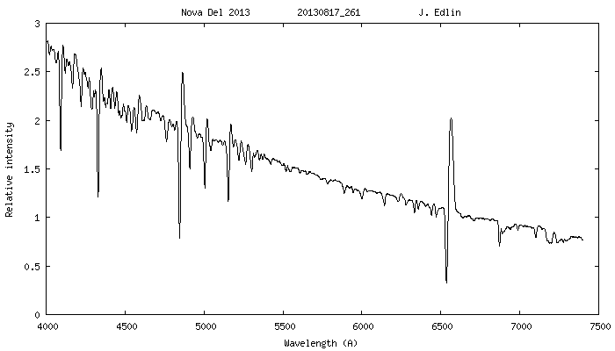
Novae | Spectroscopy
Evolution
❶ Maximum
Blue continuum
Metallic lines in absorption
Faint emission (Balmer lines, Fe II (42)
P Cygni profiles
F. Teyssier January 2021

Slide 11
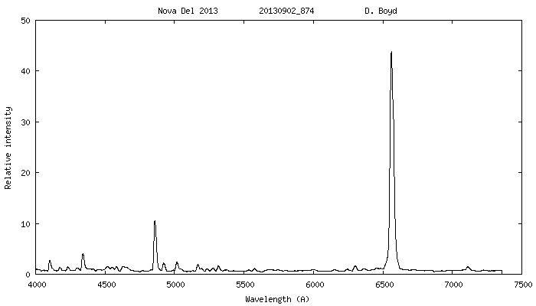
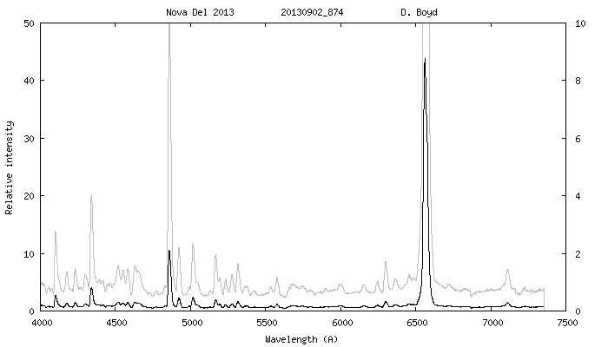
Novae | Spectroscopy
Evolution
❷ Transition
Fading of thecontinuum
Increasing of the emissions/Fading of the absorptions
Emergence of Nitrogen, Oxygen, Helium …
Apparition of « forbidden» lines: [OI], [NII], …
[O I]
He I
F. Teyssier January 2021

Slide 12
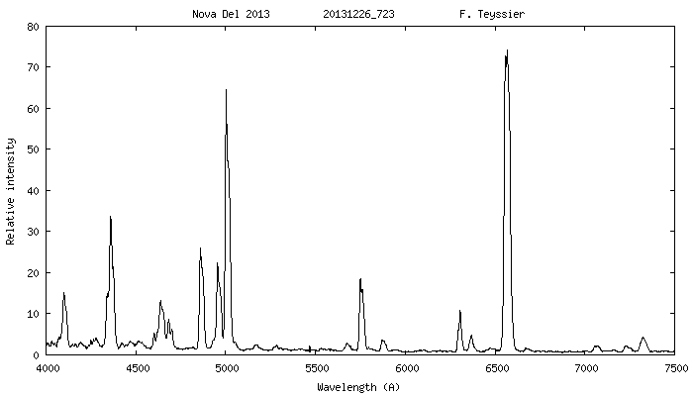
Novae | Spectroscopy
Evolution
❸ Nebular phase
Very faint continuum
« Forbidden » lines very intense
[O III]
F. Teyssier January 2021

Slide 13
Novae | Spectroscopy
Development of the spectrum
McLaughlin, 1942, 1943
Delta mag/maximum
Premaximum absorption | 1.5
Maximum light | 0
Principal absorption | 0.6
Diffuse enhance absorption | 1.2
Maximum diffuse enhanced | 2
Orion absorption | 2.1
[OI] flash | 2.6
Maximum Orion | 2.7
Disparition diffuse enhanced | 3
4640 emission | 3
[NII] flash | 3.3
Disparition Orion | 3.3
Helium flash | 3.6
[OIII] | 3.7
Disparition Principal absorption | 4.1
Disparition "4640" | 4.7
[OIII]4363 = Hg | 4.9
[OIII]5007= Hb | 5.4
[OIII] 4959 = Hb | 5.8
[OIII] 4959/Hb = 1.5 | 6.4
[OIII] 4959/Hb = 2.0 | 6.7
[OIII] 4959/Hb = 5.0 | 8.5
[OIII] max | 9.5
pm
p
pe
o
F. Teyssier January 2021

Slide 14
Novae | Spectroscopy
Development of the spectrum
An example of flux measures
Nova Cyg 2014
JD – 2450000
Flux en erg.cm⁻².s⁻¹
F. Teyssier January 2021

Slide 15
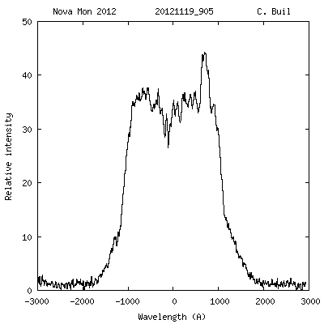
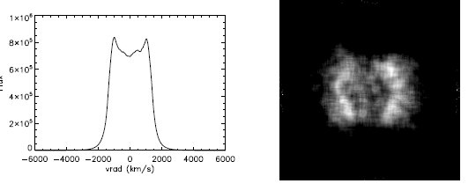
Novae | Spectroscopy
Profiles of the lines → Shape of the ejecta
Monte Carlo
Shore & al., 2012
Radial velocity (km/s)
F. Teyssier January 2021

Slide 16
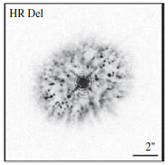
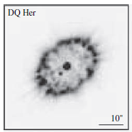
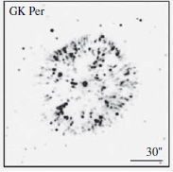
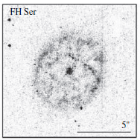
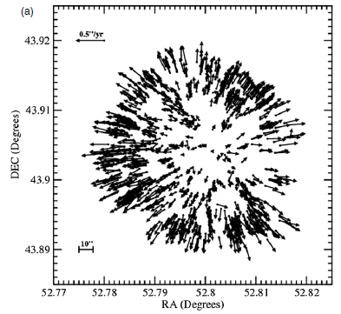
Novae | Images of Remnants
Remnants
Sperical,
often low excentricity :1 à 1.2 (1.4)
Clumpy
Sometimes rings, lobes
GK Per
O’ Bien & Bode in Classical novae, 2008
Shara & al., 2002 HST
F. Teyssier January 2021

Slide 17
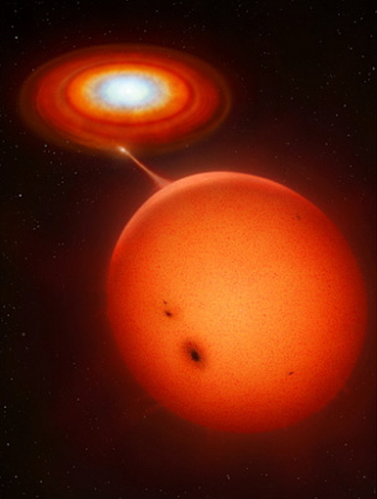

Novae | Cataclysmic Stars
~1 R
Accretion disk
… but polars
(H, He)
White Dwarf (WD)
Transfert de matière
(« solar composition »
(H, He)
M’ = 10⁻¹⁰ à 10⁻¹¹ M/year (Porb < 3.3 h)
M’ = 10⁻⁹ à 10⁻¹⁰ M/year (Porb > 3.3 h)
Donnor Star
Main sequence star
Type M-K
(cool, red)
Orbital period
~ A Few Hours
~1 R
~ 1 000 000 km
M’ 3/10000 à 3/1000000 Mt
F. Teyssier January 2021

Slide 18
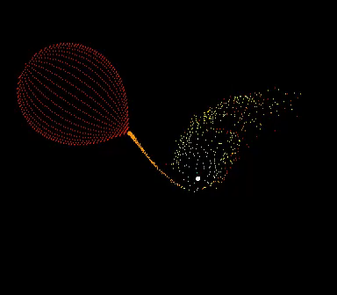
Novae | Etoiles cataclysmiques
Accumulation of matter in the accretion disk
Increase of the viscosity
Sharp increase of the temperature (5000 → 15000 K)
= Thermal Outburst
Amplitude : 2 - 8 mag
Frequency : days to years
Fast increase of the luminosity ~ 1 day
Duration : a few days
« Dwarf nova » outbursts
SS Cygni – Luminosity curve (V) – 2 ans - AAVSO
F. Teyssier January 2021

Slide 19
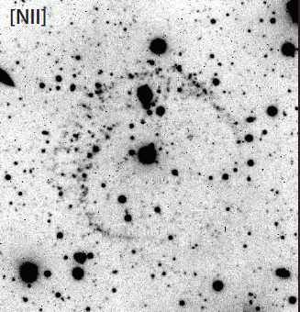
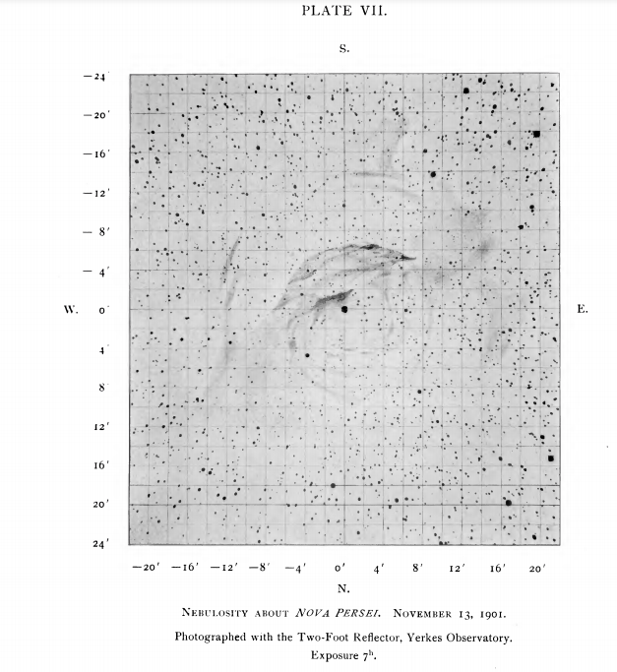
Novae | Cataclysmic Stars
AT Cnc
GK Per Nova Per 1901
Shara+, 2012
Nebulosities detected
around a few catalymic stars
= remnants
of « old » nova outbursts
F. Teyssier January 2021

Slide 20
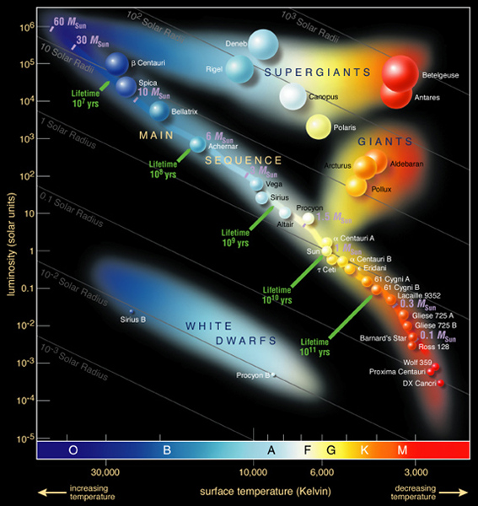
Novae | White Dwarf
White Dwarf
Terminal phase of the stellar evolution
for Stars < 10 M
End of thermonuclear reactions
Condensate matter « cool »
In the thermodynamic sense: nuclei are « frozen »
Only the move of electrons maintain the structure
Cooling (100 000 K →)
Nébuleuse
planétaire
Géante rouge
Several « savors » depending
of the masse of the progenitor
Type | Main | Initial mass | Masse finale
CO | Carbone Oxygène | < 9 M | < 1.1 M
ONe | Oxygène Néon | 9 M < M < 11 M
He | Hélium |  | Low
White Dwarf
Mean masse= 0,6 M
If M > 1,4 M : supernova Ia
(Chandrasekar’s limit)
Valeurs approximatives
Voir Doherty & al., 2010
Magnetic field:
Great range from classical to polar (no accretion disk)
F. Teyssier January 2021

Slide 21

Novae | White Dwarf
$$R=0,0126×\left(\frac{2}{Mⅇ}\right)×M^{−\frac{1}{3}}×{\left[1−{\left(\frac{M}{M_{Ch}}\right)}^{\frac{4}{3}}\right]}^{−\frac{1}{2}}$$
0.6 M
White Dwarf « WD »
1.0 M
Rayon
1.3 M
Very large variations of the physical quantities
as a function of mass
Densité
Gravité
F. Teyssier January 2021

Slide 22
Novae | White Dwarf
« Normal » Matter
Condensed Matter « degenerated »
Perfect gaz law
P.V = n.R.T
+
+
P ≡ ρ . T
+
-
-
+
+
+
-
-
-
+
-
+
En l’absence de confinement :
Temperature increase
⇨ Volume increases
+
+
-
-
+
P ≡ ρ^{γ}
Increase of Temperature and Pressure
The volume remains constant
Thermal Energy of the électrons < Energie de Fermi
3/2 k T < E_{F}
F. Teyssier January 2021
Notes:
Arrêt des réactions nucléaires: la gravité l’emporte sur la pression de radiation

Slide 23
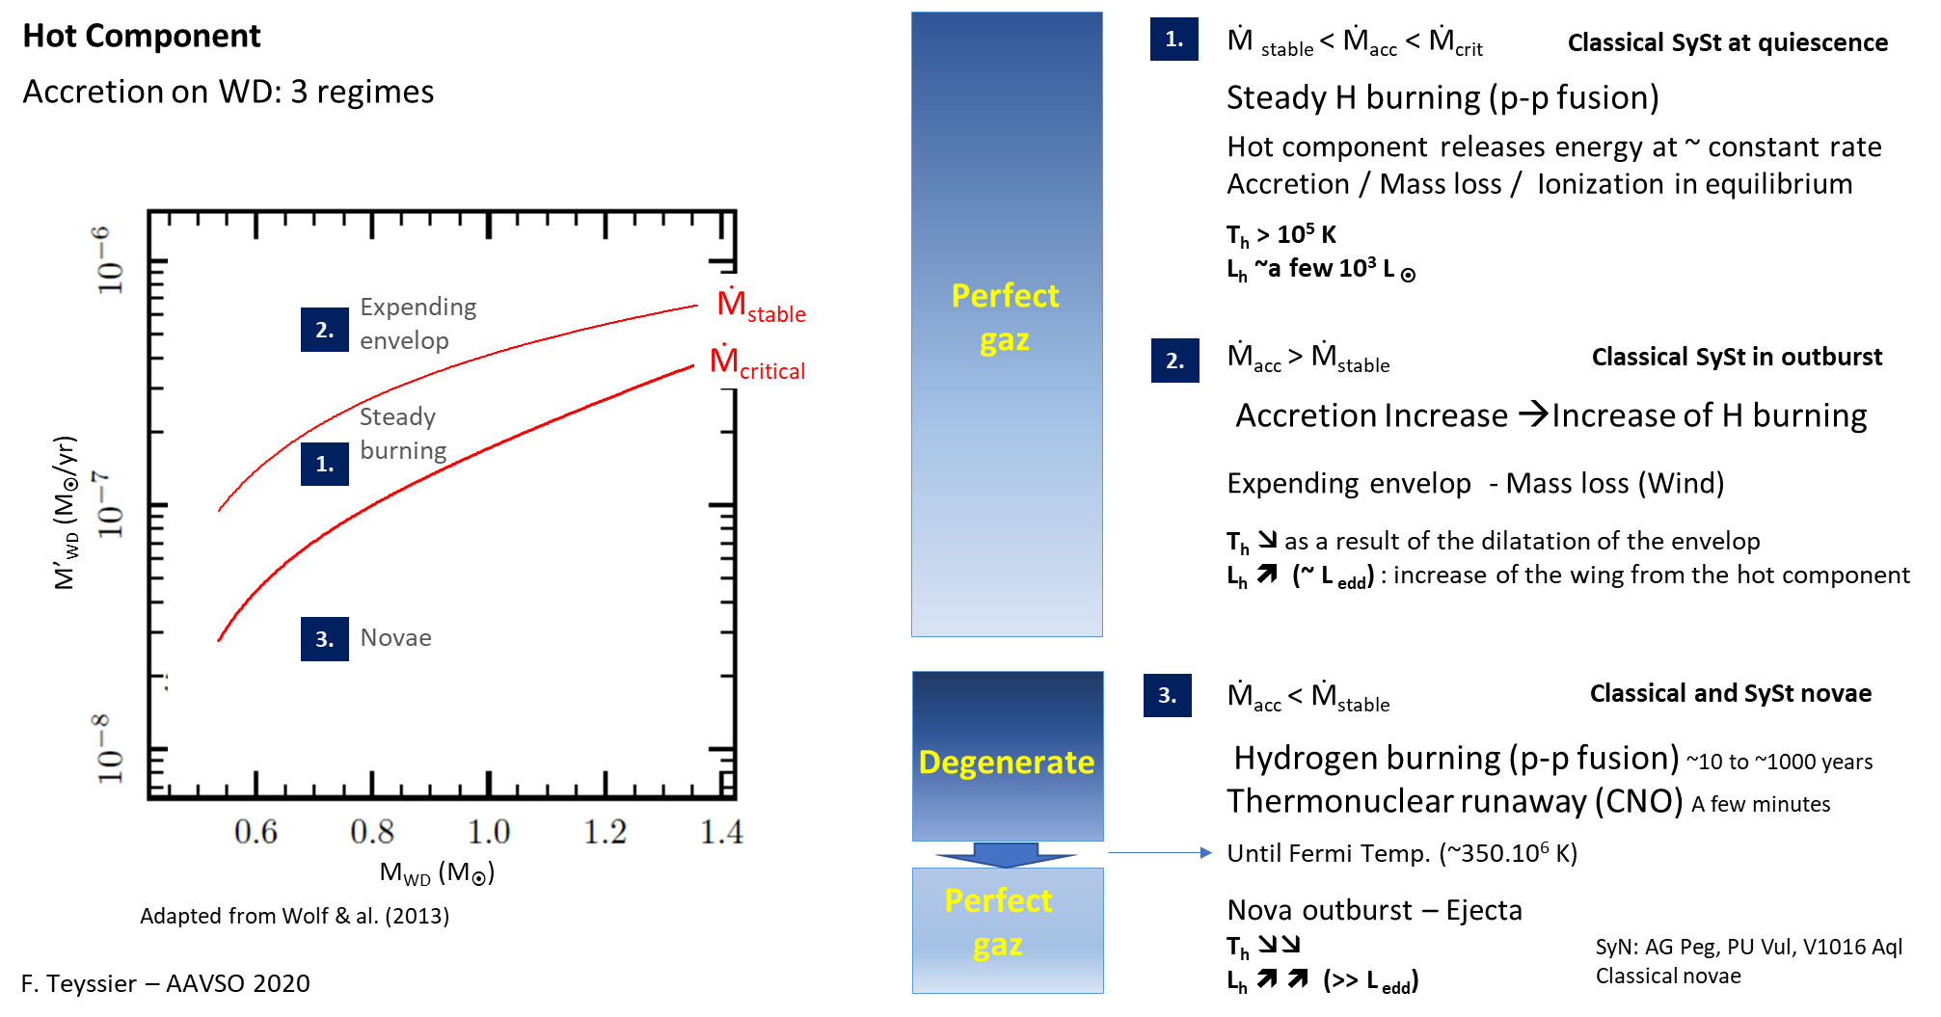
Novae | White Dwarf
F. Teyssier January 2021
Notes:
Arrêt des réactions nucléaires: la gravité l’emporte sur la pression de radiation

Slide 24
Novae | Accretion on the White Dwarf
Accretion
From the donor star via the accetion disk
Constitution d’une enveloppe H, He, +++ at the surface of the White Dwarf
« Solar Matter»
Newton’s « Fuel »
H - He
C O
Accretion disk
Envelop H ~ ++10 kms
F. Teyssier January 2021

Slide 25


Novae | Accretion on the White Dwarf
Accretion at the surface of the WD
(+++ 1000 années)
Apport d’énergie
Gravitationnelle
Envelope
H - He
$$P= \frac{G.Mwd.Menv}{4.π.R_{wd}^{4}}$$
C O
C - O
$$P ≡Mwd.Menv$$
Pressure increases until P_{crit} ~ 10¹⁹ à10²⁰ dyn.cm²
P_{crit} depends:
- WD mass
Composition of the WD & accreted gas
Accretion rate
WD Luminosity
Mass of the envelop for Pcrit = 10²⁰ dyn.cm⁻²
As a function of the WD masse (in units of solar mass)
Starrfield, 1989
F. Teyssier January 2021

Slide 26
Novae | Accretion on the White Dwarf
Model for:
M_{wd} = 1 M
Accretion
(+++ 1000 years )
M’ = 10⁻⁸ à 10⁻⁹ M/an
M_{env} = 10⁻⁴ M
H - He
T ~ 1.2 10⁷ K (12 000 000 K)
C – O
Pcrit = 3.10¹⁸ dyn.cm⁻² (3.10⁻¹² atm)
Mixing (?)
Enrichissement
enveloppe
en C, O
-
Proton – proton chain
Constant Volume
(degenerated mateer)
Increase of the
- Temperature (slow: radiation, électrons)
- Density
- Pressure
+++ 1000 years )
+
+
ν
-
+
¹H + ¹H + e → ¹D + ν
F. Teyssier January 2021
Notes:
Ordres de grandeur

Slide 27
Novae | Nova
T = - 1 month to -600 sec
The energy released by pp nuclear burning increases:
Strong increase of the temperature (radiation/electron conduction insufficient)
The TNR begins
Onset of the convection in a very thin layer
H - He
T ~ 2.5 10⁷ K (25 000 000 K)
C – O
93 s
102 s
176 s
CNO Cycle « Cool »
862 s
Rouge : half live
F. Teyssier January 2021

Slide 28
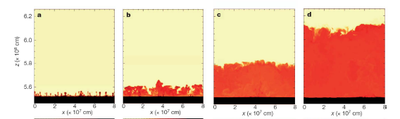
Novae | Nova
T = 0 sec
Convection reaches the surface of the envelope
« Hot » CNO cycle
H - He
T ~ 6 10⁷ K (60 000 000 K)
C – O
93 s
102 s
176 s
862 s
Rouge : demie vie
F. Teyssier January 2021

Slide 29


Novae | Nova
T = 600 sec
V ~ 10 km.s⁻¹
H - He
T ~ 8 10⁷ K (80 000 000 K)
C – O
3D simulation
Casanova & al., 2011
T > Fermi Temperature (T_{F})
→ The matter of the envelope becomes « normal »
Expension of the envelope: Nova Event
Energy production undergoes
(β+ decay)
$$TF=3.107 x {\left(\frac{ρ^{3}}{μe}\right)}^{2/3}$$
F. Teyssier January 2021

Slide 30
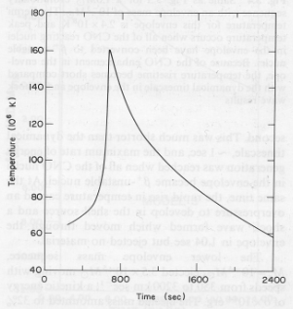
Novae | Nova
T = 700 sec
V ~ ++ 10 km.s⁻¹
H - He
T ~ 1.6 10⁸ K (160 000 000 K)
C – O
Maximum temperature
Runaway:
Very short time scale
+++ 100 secondes
E = 1.10¹⁵ erg.g⁻¹.s⁻¹ (25000 kcal.g⁻¹.s⁻¹)
F. Teyssier January 2021

Slide 31

Novae | White Dwarf TNR
t = a few hours
T ~ 5 10⁵ K (500 000 K)
Dilatation of the envelope
The temperature decreases
~ 1.10⁶ km.h⁻¹
Luminosity L ~ 10⁵ L
Luminosity near or above Eddington Luminosity (L_{edd})
Increase of the velocity
Valeur approximative
Orbit of the donor star inside the expending envelop
Speed of the ejecta (?)
Shape of the ejecta (?)
Blobs (?) from Lagrangian points (?)
Scale ~1 million km
F. Teyssier January 2021

Slide 32
Novae |
Fireball stage
t ~ 1 day
Release of the ejacta (how and when?)
V = 300 à 2400 km.s⁻¹
Mass of ejecta = 3,5.10⁻⁵ M
~ 1/3 envelope
T ~ 12.10³ K (12 000 K)
Heterogeneity
Bipolar lobs(?)
Rings (?)
…
Scale ~ 50 millions of km
F. Teyssier January 2021

Slide 33
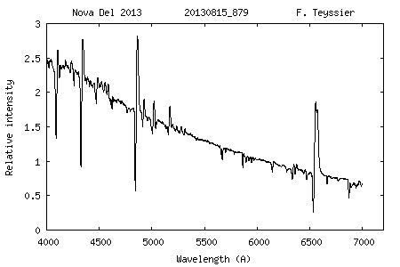
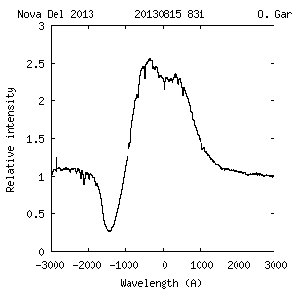
Novae |
Fireball stage
T ~ 1 day
V = 700 à 2400 km.s⁻¹
T ~ 12.10³ K (12 000 K)
Photosphere
Ejecta optically thick
Many « metal » lines in absorption
« Iron curtain »
Fe II emission + P Cygni profiles
Balmer Lines (HI) : deep P Cygni profiles
Scale ~ 50 millions of km
Radial velocity(km/s)
F. Teyssier January 2021

Slide 34
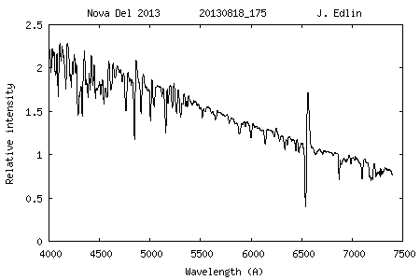
Novae |
t ~ a few days
Max Luminosity
Envelop at its maximum radius
R_{env} ~ 300 R (200.10⁶ km)
The temperature lowers
V = 700 à 2400 km.s⁻¹
T ~ 5.10³ K (5 000 K)
Ejecta optically thick
Photosphere near the surface of the ejecta
Scale ~ 100 millions de km
F. Teyssier January 2021

Slide 35
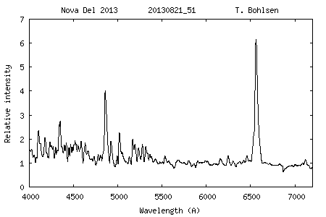
Novae |
1st decline
T ~ 10 days
The envelop recedes (Gravity)
The ejecta extends
V = 700 à 2400 km.s⁻¹
In the ejecta
Recombinaison
H⁺ + e⁻ → H⁰
T ~ 10 000 K
Increase of the emissions
Scale ~ 100 millions de km
F. Teyssier January 2021

Slide 36
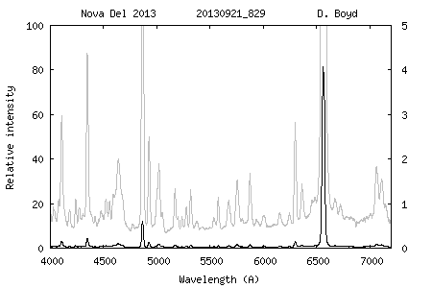
Novae |
T ~ 30 days
Contraction of the remaining envelop
Rise of the temperature
(50 000K)
Shift of the peak of luminosity toward UV
Fading of the continuum in the visible range
Photo-oinisation +++ of the ions in the ejecta
V = 700 à 2400 km.s⁻¹
T = 50 000 K
The density of the ejecta decreases
Formation of forbidden lines
(Collisionnally excited lines)
High density zones, blobs
= heterogeneity of the ejecta
Ejecta optically thin
F. Teyssier January 2021

Slide 37
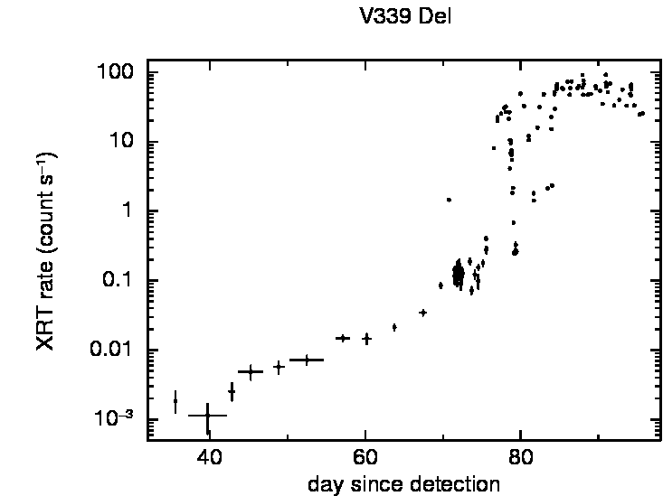
Novae |
T ~ 80 days
Dilution of the ejecta
Optically thin at all wavelength
High energy level(100eV à 1keV)
Super Soft Source
BUT: Dust can forms in some novae (Dust dip in the LC)
V = 700 à 2400 km.s⁻¹
T = 100-150 000 K
Swift
F. Teyssier January 2021

Slide 38
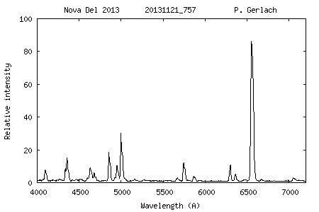
Novae | White Dwarf TNR
Phase nébulaire
T ~ 80 jours
Ejecta optically thin
Heterogene
High ionisation lines
[OIII], He II, Fe VII, Fe X …
V = 700 à 2400 km.s⁻¹
T = 100-150 000 K
F. Teyssier January 2021

Slide 39
Novae | White Dwarf TNR
Nebular Phase
T ~ +++ years
« turn-off »
Hibernation ?
Accretion, outbursts (Dwarf Nova type)
Until the next nova event
(in a few thousands of years)
F. Teyssier January 2021

Slide 40
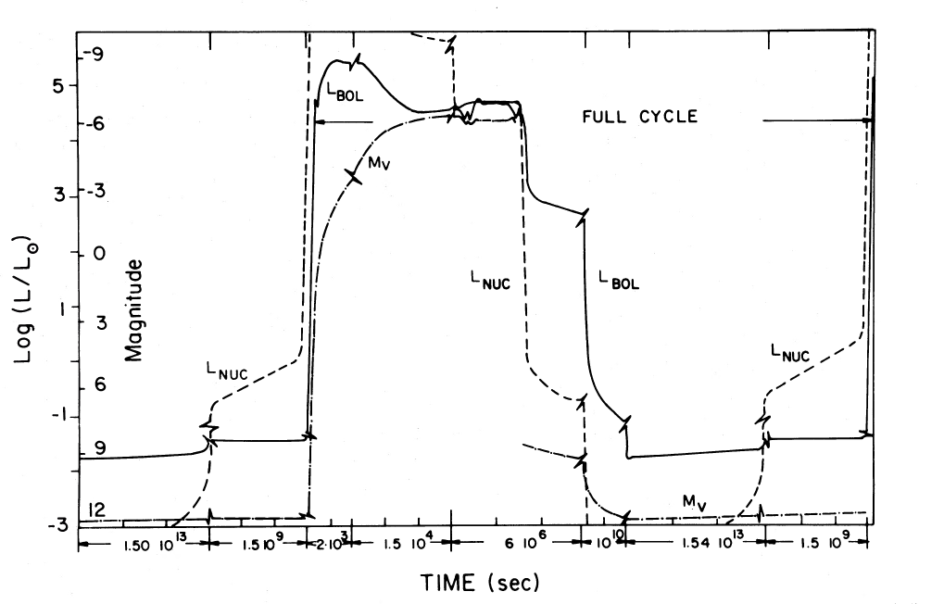
Novae | Etoiles cataclysmiques
F. Teyssier January 2021

Slide 41
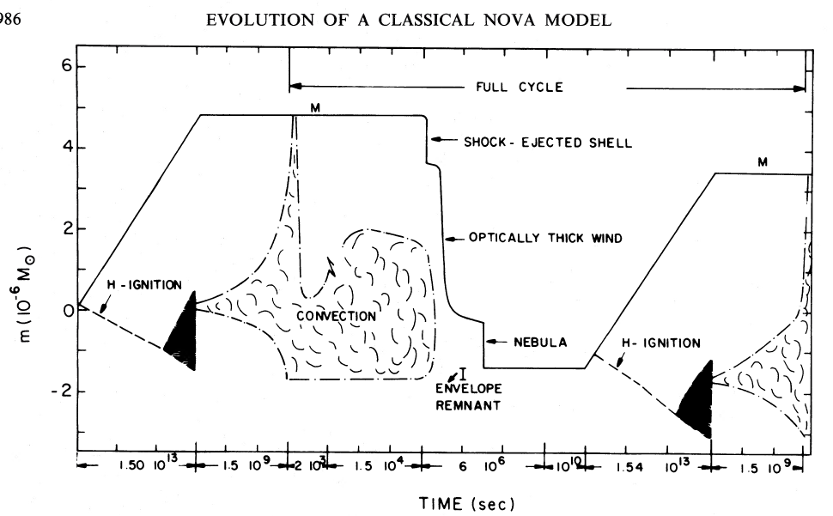
Novae | Etoiles cataclysmiques
F. Teyssier January 2021

Slide 42
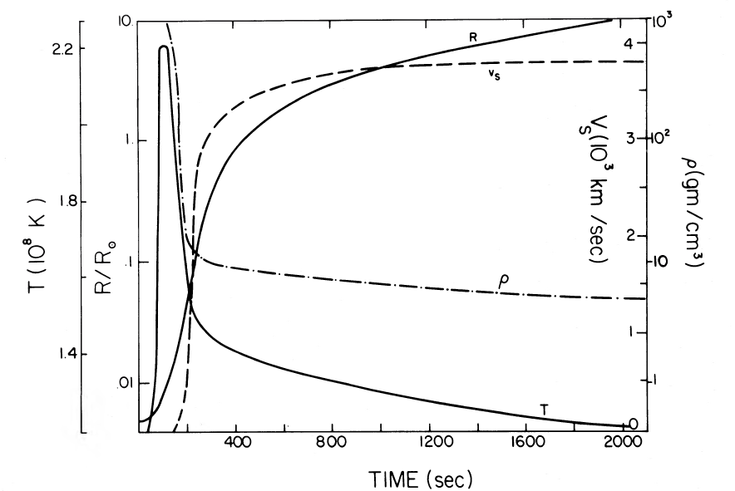
Novae | Etoiles cataclysmiques
F. Teyssier January 2021

Slide 43
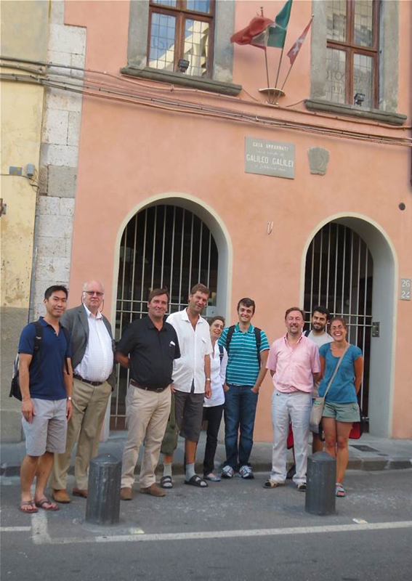
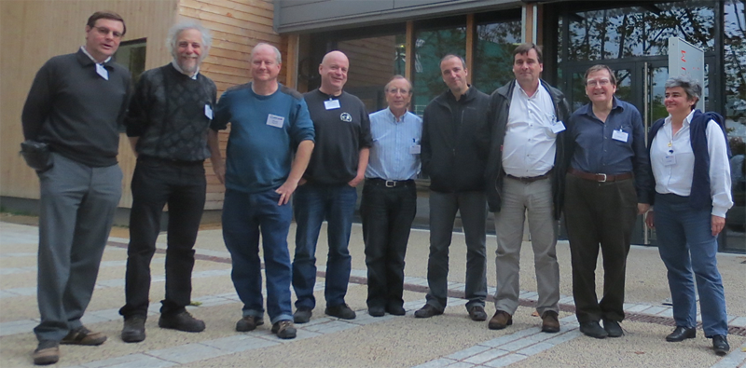
Novae | ARAS
The sort of program I have in mind could not be accomplished by one person, or even one observatory. [...] It would require co-operation between two or more observatories, and would involve the use of six or more intruments
Aside from the direct comparison feature, has not been done before ? The answer is yes it has in an utterly hapzard and unco-ordinated fashion. Each observer has obtained a record of the nova that served his propose very well. But when any attempt was made to synthesize the material, what a hodgepdge ! There has been cooperation, but only after the nova had run its course.
What is required is pooling the effort and ressources during the observing period.
Image that we were sufficiently clairvoyant to know that a bright nova would appear once year hence. I am sure our appoach would be very diffrent from what has caracterized previous observations of novae.
Dean B. Mac Laughlin, Problem in the spectra of novae, 1950, PASP
Observation coordonnée d’une nova classique
dans tous les domaines de longueur d’onde
Gamma, X, UV, Visible, IR, Radio
Following an idea formulated by Mc Laughlin (1950) ,
mise en œuvre par Steve Shore (2013)
Lyon , Novembre 2013
ARAS observers and Steve Shore (WETAL 2013)
Pise, Juillet 2013
F. Teyssier January 2021

Slide 44

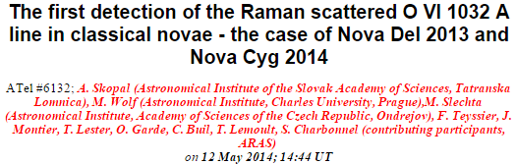
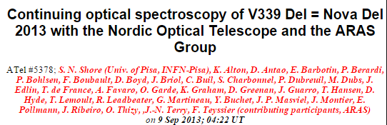
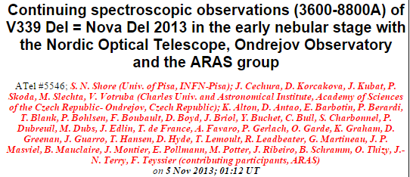
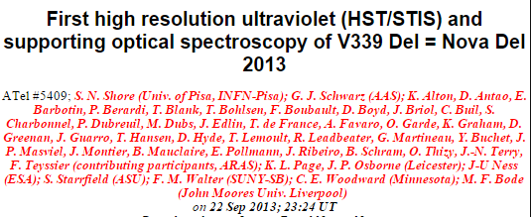
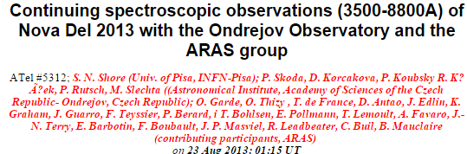
Novae | ARAS
F. Teyssier January 2021

Slide 45


Novae | ARAS
F. Teyssier January 2021

Slide 46
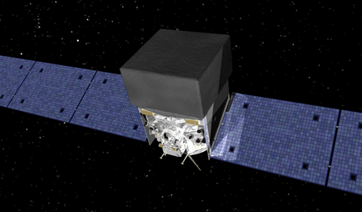
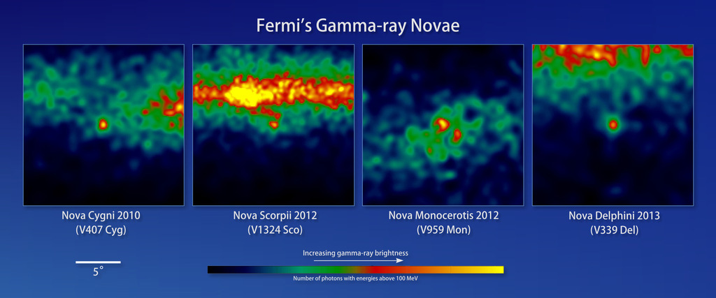
Novae | Gamma rays
Nova Del 2013
Forth nova observed in Gamma-rays, Second Classical Nova
Credit: NASA/DOE/Fermi LAT Collaboration
F. Teyssier January 2021

Slide 47

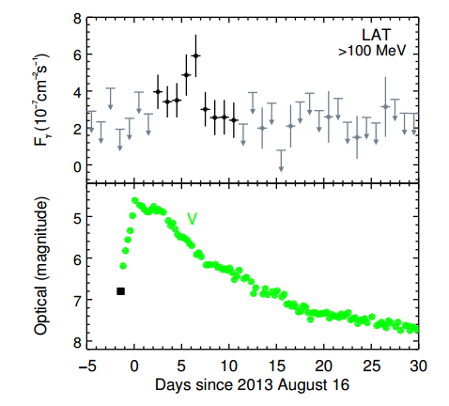

Novae | Références
Fermi establishes classical novae as a distinct class of gamma-ray sources
Science, Volume 345, Issue 6196, pp. 554-558 (2014)
Gamma Emission V339 Del
Tireless and selfless efforts
F. Teyssier January 2021

Slide 48

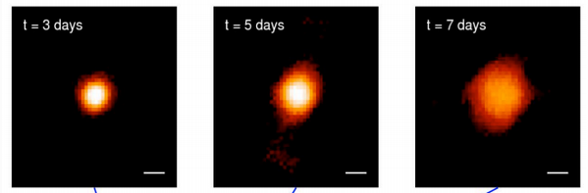

Novae | Références
The expanding fireball of Nova Delphini 2013
G.H. Shaefer & al.
26 octobre 2014
F. Teyssier January 2021

Slide 49

Novae | Références
The expanding fireball of Nova Delphini 2013
G.H. Shaefer & al.
26 octobre 2014
F. Teyssier January 2021

Slide 50

Novae | Références
The expanding fireball of Nova Delphini 2013
G.H. Shaefer & al.
26 octobre 2014
From an analysis of spectra downloaded from the archive of the Astronomical Ring for Access to Spectroscopy¹⁷, we estimated the outflow speed near the continuum-forming layer to be V_{ejection} = 613 ± 79 km s⁻¹
17 Shore, S. N. et al. Continuing spectroscopic observations (3500–8800A) of Nova Del 2013 with the Ondrejov Observatory and the ARAS group. Astron. Telegr. 5312, 1 (2013)
We thank O. Garde and other members of the Astronomical Ring for Access to Spectroscopy for use of their archive of Nova Del 2013 spectra.
F. Teyssier January 2021

Slide 51

Novae | Références
The expanding fireball of Nova Delphini 2013
G.H. Shaefer & al.
26 octobre 2014
Shore, S. N. et al. Continuing spectroscopic observations (3500–8800A) of Nova Del 2013 with the Ondrejov Observatory and the ARAS group. Astron. Telegr. 5312, 1 (2013)
distance to the nova of 4.54 ± 0.59 kiloparsecs from the Sun
F. Teyssier January 2021

Slide 52


Novae | Spectroscopy
Williams, 1991,1994
Two Spectral types
Fe II
Lines– 700 à 2500 km.s⁻¹
Fe II
Profils P Cygni
Slow Novae
He/N
Broad lines> 2000 km.s⁻¹
He N
Fast Nova
Taxonomic classifications
Model of the ejecta ‘
F. Teyssier January 2021
Notes:
C’était là où j’en étais jusqu’à rencontrer Ivan étudiant thésard de Steve Shore

Slide 53



Novae | Models
Ptolemee
A model SIMPLE: Rising Sun in the East
Physicaly Wrong
JUSTE (with +++ Eplicycles)
Imagine: ‘we « true » in the model AND have Modern Computers’
How many « epicycles » could we build?
Copernic
A model COMPLEX to understand
Physicaly Right
peu JUSTE
Kepler
A model COMPLEXE
Physicaly Right
JUSTE
« The ‘essential’ Revolution is Keplian » (FMT, 2021)
Newton: Theory + Computation (2 Bodies)
Einstein: A little bit more complex …
Future: ? (Mond ….)

Slide 54


Novae | Spectroscopy
Thèse(s)
Winds
1 ejecta + Wind(s)
Several ejecta (equatorial, tropical, polar)+ Winds(s) or no
Chocks …
Antithèse (Uniformed model):
1 ejecta
Opacité + Ionization stages
Synthèse:
?
Masson+,2018
F. Teyssier January 2021
Notes:
C’était là où j’en étais jusqu’à rencontrer Ivan étudiant thésard de Steve Shore

Slide 55
Classification of Novae
NOVAE
Classical
NOVAE
NOVAE
Fast to slow
AG Peg
RT Ser
V1329 Cyg
PU Vul
Symbiotic
NOVAE
Very Slow
S Type (Red Giant)
(N = +++100)
D Type (Mira)
RR Tel
V2110 Oph
V1016 Cyg
HM Sge
RX Pup
V407 Cyg
CN Cha
Recurrent
NOVAE
U Sco type
T Pyx type
T CrB type
Symbiotic
T CRB
RS Oph
V745 Sco
V3980 Sgr
(N = 10)
References
Allen 1980
Mürset & Nussbaumer 1994
Munari 1997
Mikolajewska 201
109

Slide 56

Novae Récurentes
Symbiotiques : T CrB RS Oph
F. Teyssier January 2021

Slide 57


Novae symbiotiques
CN Cha
My Christmas gift ☺
F. Teyssier January 2021

Slide 58



Helium Nova
V445 Pup
F. Teyssier January 2021

Slide 59
Novae | Références
White Dwarf
Masse
Température
Luminosité
Composition He →CO→ Ne
Homégénéité
Magnétisme
Enveloppe
Masse
Taux accrétion
Densité
Pression
Composition Matière accrétée + mixing
Géométrie
Rotation White Dwarf
Régime accrétion
Zone accrétion
Migration de la matière accrétée

Slide 60

Novae | Photometry - Luminosity Curves
Variations
Strope, Shaeffer, Henden, 2010
Catalog of 93 Nova Light Curves:
Classification and Properties
F. Teyssier January 2021
F. Teyssier January 2021
Notes:
J’espère que cela vous a paru simple jusqu’à maintenant

Slide 61


Novae | The novae of the second Semester 2021
Two novae with oscillations at maximum
Luminosity curves: selected and interpollated AAVSO data by David Boyd
F. Teyssier January 2021
F. Teyssier January 2021
Notes:
J’espère que cela vous a paru simple jusqu’à maintenant

Slide 62

A classic
(RS Oph Conference, 1985)
adapted by
François Teyssier
Nova Cas 2020
Nova Per 2020
‘’It’s somewhere between
a nova and something else
… probably a pretty bad nova.’’
“All right then, I’ll go to hell!”
Mark Twain
Private Message ;-)
F. Teyssier January 2021
F. Teyssier January 2021
Notes:
J’espère que cela vous a paru simple jusqu’à maintenant

Slide 63

Novae | The novae of the second Semester 2021
Nova Cas 2020
Low Resolution Spectra
Study: David Boyd
F. Teyssier January 2021
F. Teyssier January 2021
Notes:
J’espère que cela vous a paru simple jusqu’à maintenant

Slide 64

Novae | The novae of the second Semester 2021
Nova Cas 2020
Intensity of the flux of a few lines on flux calibrated spectra
Study: David Boyd
F. Teyssier January 2021
F. Teyssier January 2021
Notes:
J’espère que cela vous a paru simple jusqu’à maintenant

Slide 65





Novae | Références
Basis. A few of my favourite lectures
+ Read the « old » publications
(1930 à 1950)

Slide 66



Novae | Références
Download:
http://www.astronomie-amateur.fr/Novae/Publications.html
1956
1960
1989
2008

Slide 67




Novae | Références
Reviews

